Slide 1



National Fraud Initiative
Louise Williams

Slide 2



Agenda
Who We Are and What We Do
AppCheck, ReCheck & FraudHub
The National Fraud Initiative

Slide 3
About Us
We deploy systems in the UK and across multiple international markets
We run data centre operations in the UK and USA, with full disaster recovery capability
Independent data management company and specified anti-fraud organisation (SAFO).
Established in 1992
Our business operates according to industry standards, including ITILv3 and accreditation to ISO27001

Slide 4

The NFI is a data matching service, which matches electronic data from to prevent and detect fraud. The NFI transferred to the Cabinet Office from the Audit Commission on 1st April 2015. The NFI uses powers set out in Part 6, Schedule 9 of the Local Audit and Accountability Act 2014
To better protect the public purse from fraud and
error by helping to minimise loss
Vision
Provide the best deal for the tax-payer by helping tackle fraud and error
Use sophisticated data matching and analytics to achieve results quickly and efficiently
Work with customers and stakeholders across the public and private sector to provide capability to detect, prevent, disrupt and deter those committing fraud and discover error.

Slide 5



In partnership with
The Audit Commission/Cabinet Office since 1996
Runs every two years
Over 1300 Participants
A Big Data Solution
Over a third of a Billion records to utilise when matching data
Unique system
Brings together over 23 data sources
Over
£1.4bn Pounds saved

Slide 6


NFI Data Sets - Collected
^{State Benefits}
^{Blue Badge} ^{Holders}
^{Housing Benefit} ^{Claimants}
^{Right To Buy}
^{Concessionary} ^{Travel Passes}
^{DDRI Deceased} ^{Persons}
^{Deferred Pensions}
^{Electoral Roll}
Fraudulent Identities (Amberhill Data)
^{Housing Tenants}
^{Immigration Data}
^{Insurance Claimants}
^{Market Traders}
^{Occupational} ^{Pensions}
^{Payroll}
^{Personal Alcohol} ^{Licenses}
^{Personal Budgets}
^{Private residential} ^{Care Homes}
£
^{Credit Referencing Data}
^{Student Loans}
^{Taxi Drivers}
^{Housing Waiting} ^{Lists}

Slide 7
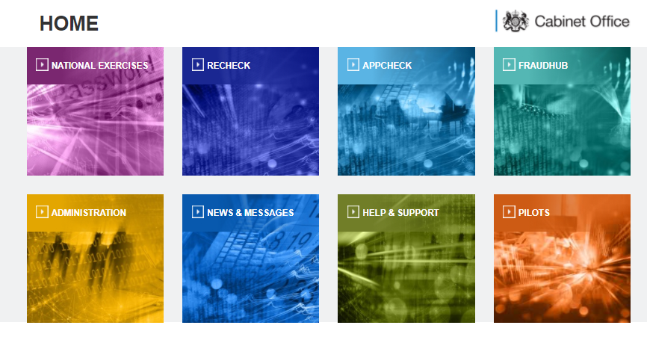

Slide 8


A flexible and cost effective system that allows you to manage and monitor ongoing customer relationship to reduce fraud.
When customer’s circumstances change can you be sure they have informed you of these, allowing you to make the necessary adjustments to benefits or services provided. NFI ReCheck allows you to retrospectively check existing customer records
NFI ReCheck allows you to run your own “Campaigns” through our web application and can be made available to multiple departments or users within your organisation to identify potential fraud and inconsistencies.

Slide 9

Ensure claimants entitlements are valid
Prioritise investigations by department
“Monitors ongoing customer activity to reduce fraud” within existing accounts
Stop invalid claims from existing customers
Reduce the likelihood of falling victim to fraud
Reduce your amount of mandated referrals
Stay ahead of your investigation caseload
Reduce your administration overhead

Slide 10


Provides Local Authorities, Government Agencies, Housing Associations, and Emergency Services who wish to work together a permanently accessible system with proven capabilities to enable you to perform regular fraud investigations and data screening whenever you need to.
Data receipt from large numbers of disparate systems and databases.
Secure management of vast amounts of highly sensitive data.
Sophisticated data matching and filtering.
Inter and intra organisational data sharing.
Syndication of results and reporting throughout large user bases.
Provides you with a proactive prevention strategy where data can be matched at anytime.
Matches against the core NFI dataset as well as numerous combinations within your Hub.
You can establish your own unique reporting and match criteria.
FraudHub enables members to submit data at anytime and as new data is submitted, new matches and insight is released to all FraudHub members.

Slide 11









Significant uplift in fraud detection
A stable, secure platform
Proactive system than informs you
of changes
“A flexible one-world view to stop more fraud”
Instant introduction of fraud strategy rules
Flexible workflow & prioritisation
Easy integration with existing systems
Powerful matching & filtering

Slide 12

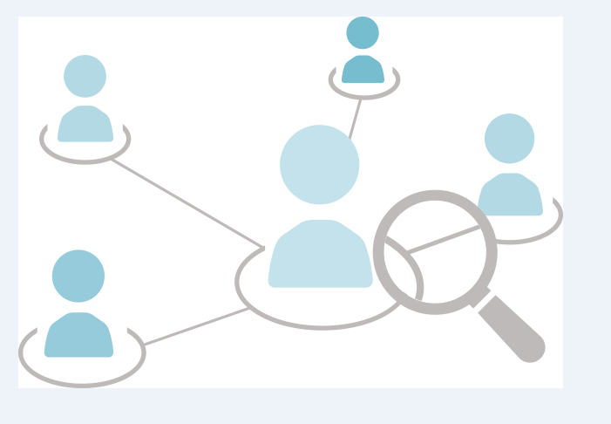
AppCheck is the fraud prevention and application verification solution, powered by the intelligence gathered as part of the National Fraud Initiative.
By validating and authenticating an individual against one of the most sophisticated data sets available. AppCheck can help your organisation reduce the number of fraudulent or mistaken claims made each year.
Every new application to an organisation brings a hidden risk that they are not who they say they are or that they fail to declare all the relevant information.
AppCheck helps reduce these risks and streamlines the process of checking applications as it is designed to help prevent fraud at the point of application.
Appcheck searches using the NFI unique data insights and expertise against comprehensive immigration, entitlement and identity information instantly delivering matched results to you.
The results either provide positive assurance of the applicant’s identity and status or indicates further investigation is required prior to application approval.

Slide 13
Reduce investigation costs
“ Stop fraud entering your organisation . Reduce risks and streamline your fraud prevention capability”
Stop invalid claims at the point of application
Ratify your governance processes
Reduce Risks and streamline your processes
Mitigate employment legislation breaches
Identify genuine applicants faster
Prioritise cases for investigation

Slide 14


Address
NINO
Date of Birth
Name

Slide 15
Address
NINO
Date of Birth
Application Verification
Name
Fraud Prevention

Slide 16


Address
NINO
Allows your front line teams and counter fraud function to easily check the validity of an application in real-time.
Date of Birth
Name
Fraudulent or mistaken applications can be identified and prevented before the application is accepted.

Slide 17
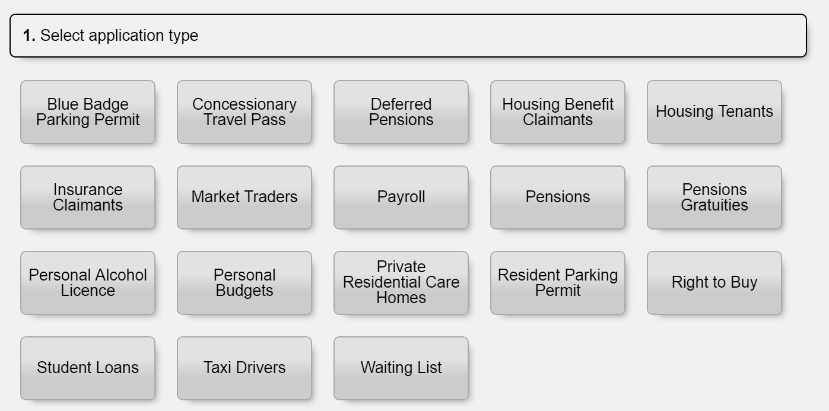
Step 1: Select the Application Type.
17

Slide 18
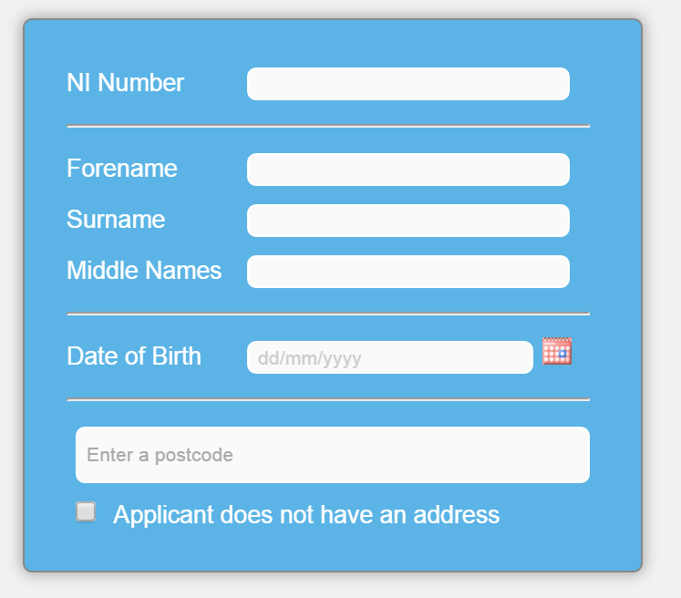

Step 2: Enter the Applicant’s Details and Select Search
TIP: Be very careful when inputting the application details.
Albert
Einstein
05/04/1970
Minimum Input Requirements
Surname & Forename and Date Of Birth
Surname & Forename and Address.
DUMMY DATA
18

Slide 19



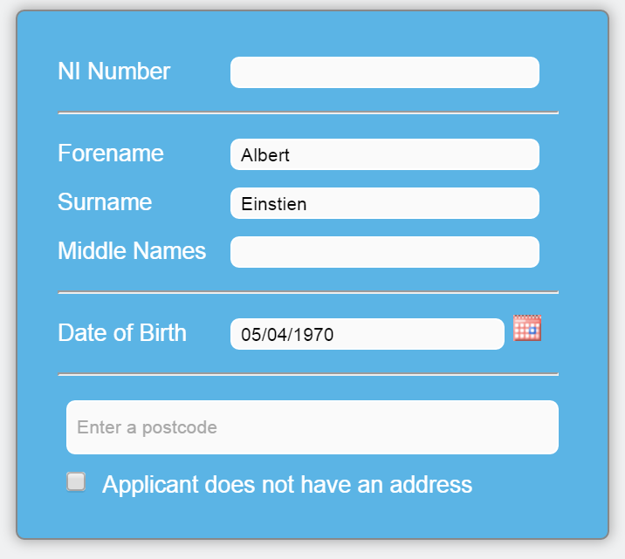
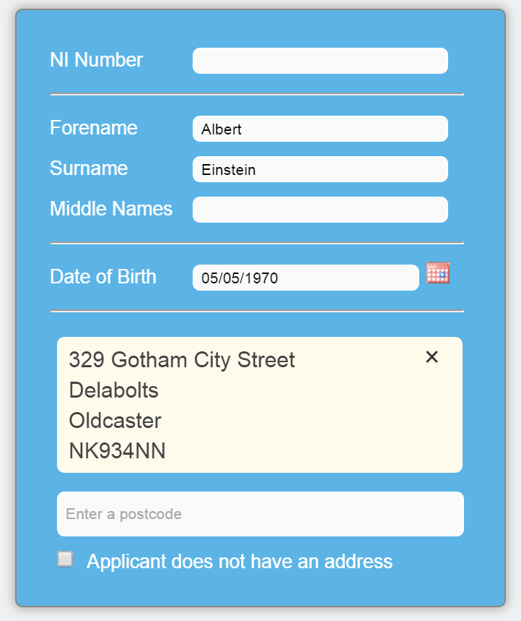

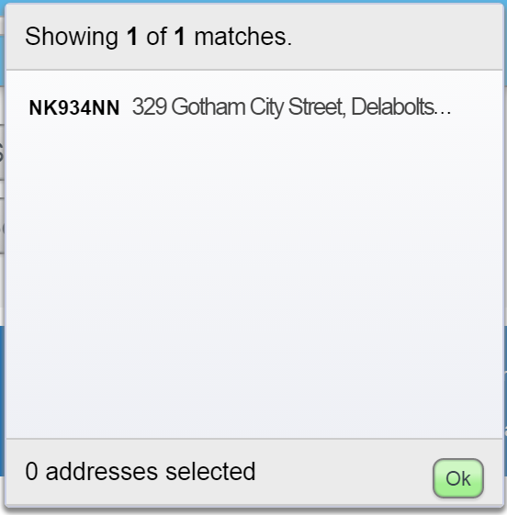



Address Input
Input the postcode of the address
A drop down list of related addresses will be displayed
AppCheck will populate the address field
Select the relevant address
Confirm by selecting ‘OK’
DUMMY DATA
Note: If the applicant does not have an address, select the tick the box
19

Slide 20



Result Indicators
Verified: the data match verifies the details of the application
Review: the data match contradicts the details of the application
Potential Fraud: the data match indicates the application may be fraudulent
20

Slide 21
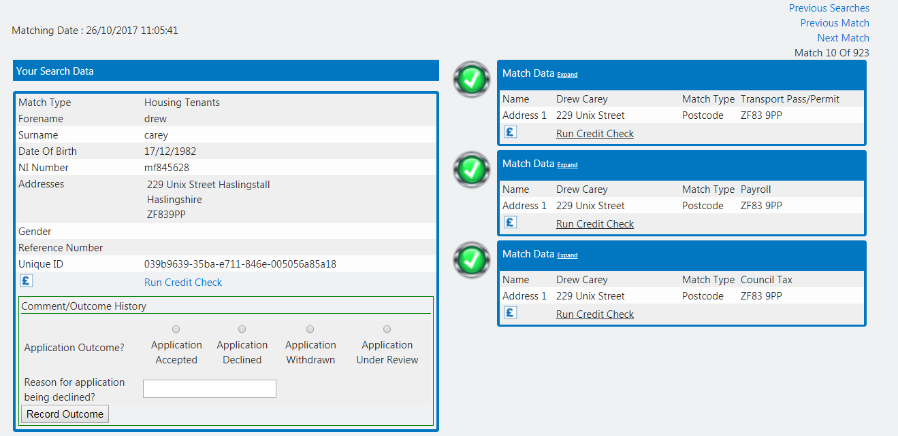
How the display screen appears
Your search data
Your match data
DUMMY DATA

Slide 22
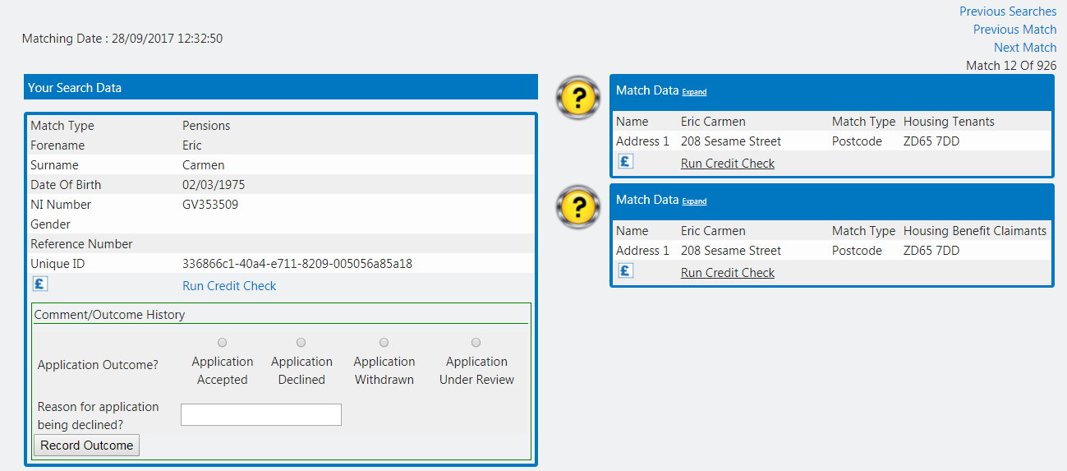
Requesting a Pre-Investigation Credit Check or List of Residents Report

Slide 23
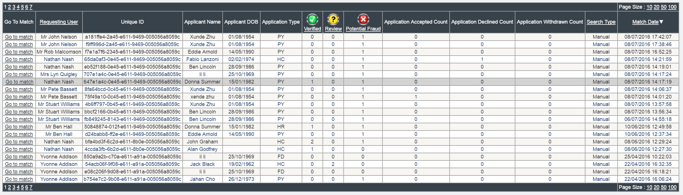
Previous Search Results
All previous searches will be displayed or a filtered subset if you chose to apply filter criteria.
You can drill down to a previous search result to view or amend it by selecting the ‘Go to Match’ option
DUMMY DATA
23

Slide 24

What the NFI Initiative is all about
Overview of the services available to support you
Insight into AppCheck how it can be used
To access your FREE TRIAL TODAY PLEASE CALL
0845 3458019

