Slide 1


The Rise of Public Health Act Funerals
Notes:
SLIDE 1: THE RISE OF PUBLIC HEALTH ACT FUNERALS
Good Afternoon. My name is Simonne Llewellyn and I am the Deputy Managing Director at Finders International.
Finders are international probate genealogists, which means that we trace missing or unknown next of kin and beneficiaries to estates when someone has passed away.
We offer a free next of kin tracing service to Public sector services, and currently have many large local authorities and NHS Trusts using our services as well as coroners and other public services. We should emphasise, as people are often unsure, that this service is genuinely free of charge to all public sector services.
Some of you here today may already use our services, but for those of you that are thinking of using us, we hope today's presentation will be of interest.
We are also exhibiting here today, so please feel free to visit us at our stand.

Slide 2
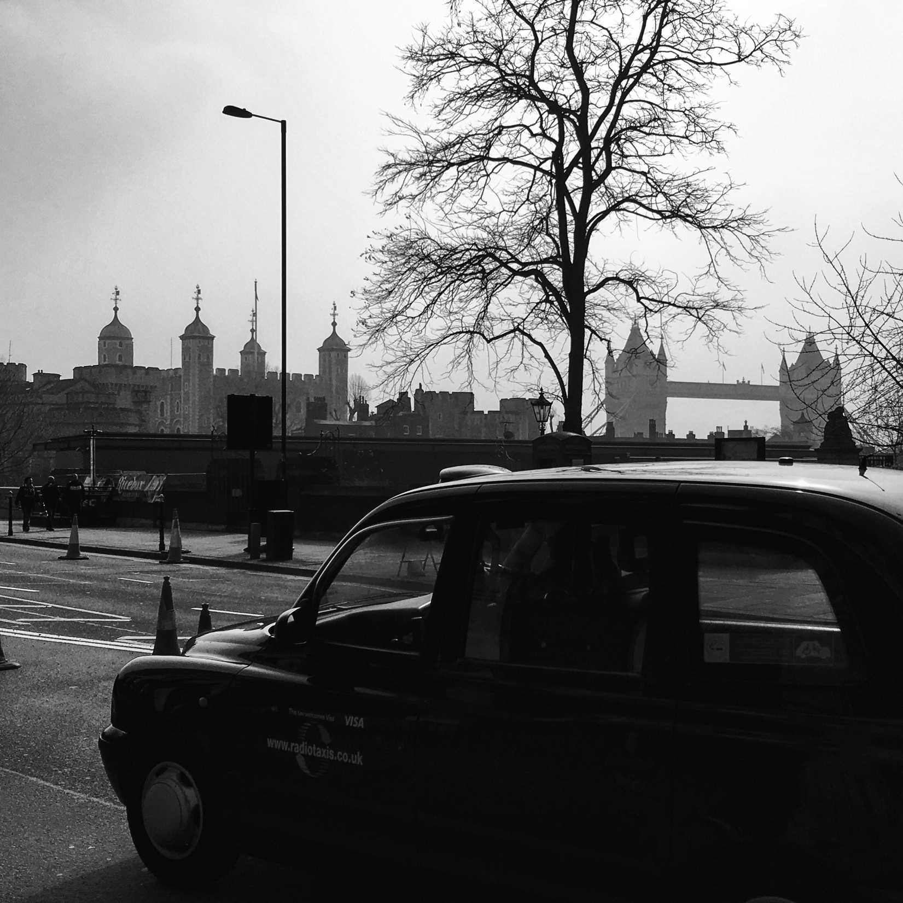
Our History
Established 1997
Offices in London, Edinburgh
& Dublin
Our UK & Ireland team is
over 70 strong and we
provide services across the
UK and worldwide
Notes:
SLIDE 2: OUR HISTORY
Finders International was formed in 1997. We have over 70 staff in our Head office in London, and our other offices in Edinburgh and Dublin.
We also have many regional representatives, most of whom are retired police officers, and they supplement the work we do in house. Research methods have evolved over the years, but despite the internet and other sources we still find, surprisingly often, that we have to send someone to make enquiries on the ground. Our regional representatives may visit the Deceased's last known address and speak to neighbours, in order to build a picture of the Deceased’s life and family, and they also visit heirs that are traced for us, especially in cases when close next of kin are involved, as they are well versed in dealing with the imparting of death messages sensitively and appropriately.
In many cases, the next of kin we locate are elderly and prefer a face to face visit where they can ask questions and ensure that they understand the situation fully.
By having regional representatives around the country, this also means that research carried out in London can be imparted to relatives locally the same day, and research therefore completed swiftly.

Slide 3


Our History
We trace heirs and next of kin to over 1000 Estates every year.
Most of our work is for public service authorities, solicitors and legal professionals - over 4,000 have used us.
Notes:
SLIDE 3: OUR HISTORY
In the last year we have worked on over 1,000 cases and we find living relatives in nearly all cases. We often hear and speak to people who claim that there were no next of kin at all, but our research regularly turns up previously unknown heirs who could be anything from children of the deceased to half-blood cousins who have no idea who the deceased was.
Our roots as a company are based in serving the legal profession, so we have a solid base of professional clients and legal knowledge, which holds us in good stead when working with all sectors. These days we find that our work for the public sector is on the increase as awareness is rising as to how we can assist in lowering the cost of public health act funerals, and the administration costs of the local authorities as a whole.

Slide 4

We’re on TV
We are a main firm in the popular BBC television series
Heir Hunters
Notes:
SLIDE 4: HEIR HUNTERS
Many of you may have seen the BBC television programme ‘Heir Hunters.’ We have appeared on the last three series and the next series is currently being filmed. As I am sure you are all aware, genealogy has become quite a fashionable past time and there are a number of television programmes around this subject. We have found that the programme has helped with the overall perception of what we do, and also enabled the public to understand our area of work. As a result of our involvement with the television programme we have found that the public are far more willing to discuss their family history with us, and become involved with the cases we handle. It’s also gone a long way towards making Finders International a well-known and trusted brand name in our business.
We have a short clip of Heir Hunters to show you now:

Slide 5
Our Ethos
We are passionate about our work
We work to a Professional Conduct Code
Our aim is to be prompt, courteous and professional
Our success is attributed to providing a fresh approach to our work
We are committed to providing a no-nonsense, fast and friendly
service
We always ensure that the highest standards are maintained
Notes:
SLIDE 6: OUR ETHOS
For those of you that have not seen the show before I hope that provides you with some insight.
We wanted to portray the professional side of the business as much as we could and we have dealt with issues such as adoption and illegitimacy through to some truly amazing stories of people who have known nothing of their family their whole lives only to be told their family history by us along with receiving news of a windfall.
The experiences of working on the show has taught us even more about the work we do and the reactions it can provoke, giving us greater insight into how to best serve our clients in all sectors.
It has also shown us that our core values of a frank and friendly approach whilst maintaining the highest standards are still as relevant today as they were when the company first started.
A final point to note is that, amongst the very positive feedback we have received, we can even boast of higher viewing figures than Jeremy Kyle!

Slide 6







Our Credentials...
Approved agents for Aviva Insurance
Association of Professional
Genealogists (APG)
In order to join the APG we agree
to abide by their Code of Ethics.
ISO Certification
We have been awarded the ISO 9001:2008 Total Quality Management Certification and the ISO/IEC 27001:2005 Data & Information Security Management Certification.
Financial Conduct Authority
We are authorised and regulated by the
Financial Conduct Authority and hold
£1.5m Professional Indemnity
Insurance.
Information Commissioners Office
Data protection registered. No. Z6654345
Notes:
SLIDE 7: OUR CREDENTIALS
Read through logos on page and explain briefly each one,

Slide 7

The IAPPR
The IAPPR is a voluntary registered scheme. We promote the interests of professional probate researchers, genealogists and heir hunters because we believe these professionals are important members of the legal services industry.
Notes:
SLIDE 8:
Our Credentials, continue list form above, note IAPPR

Slide 8
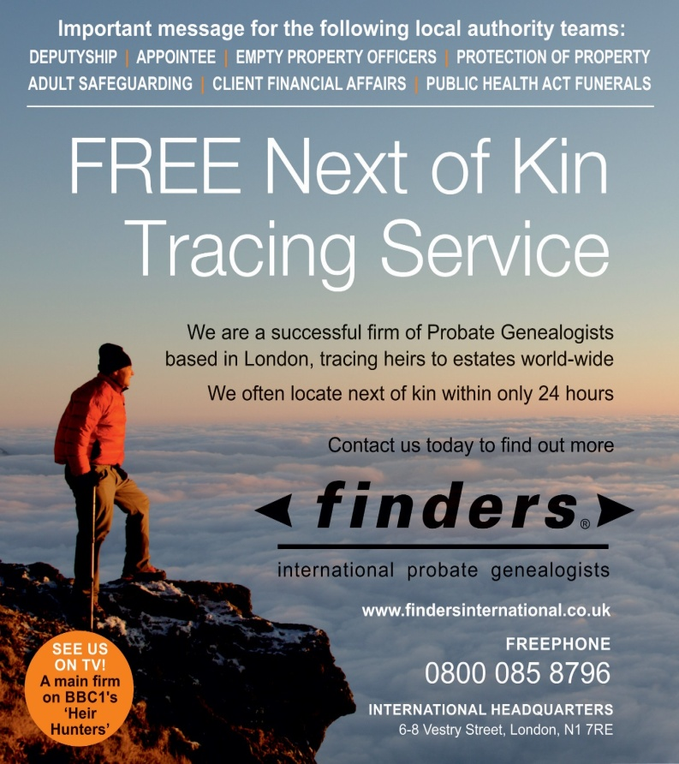
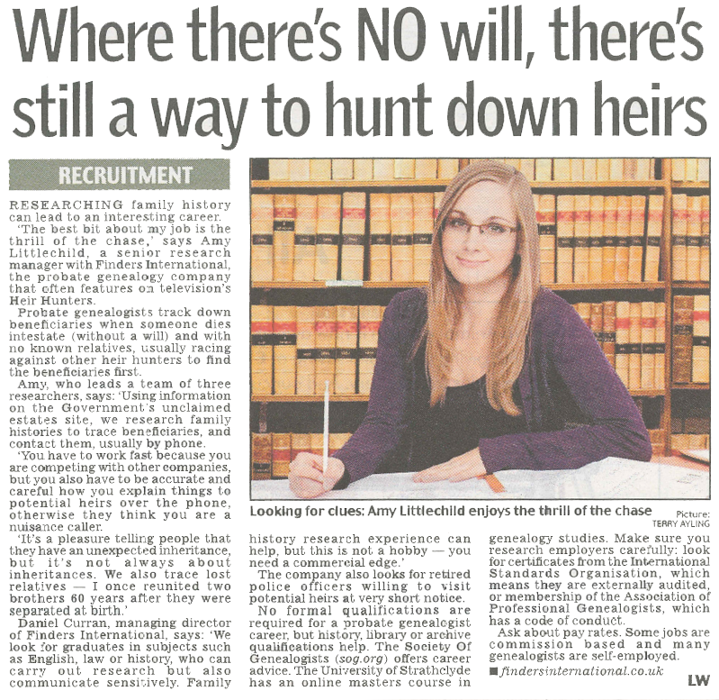
Media Attention
The Municipal Journal
Environmental Health News
Pharos and the ICCM
The Times
The Daily Telegraph
and many more…
Notes:
SLIDE 9
Aside from the Credentials we have acquired over the years, the increased media attention on our business means that we have featured not only in mainstream and national press, but also in key trade publications, such as the ones listed here and which we hope many of you may have seen.

Slide 9
What We Do
We provide a FREE effective, modern and efficient
Next of Kin Tracing service
We work with hospitals, coroners, district, county and unitary councils, Appointee and Deputyship teams and others
We can often find heirs in only 24 hours
The speed of our service means families are often
able to attend the Deceased’s funeral and inherit the
estate sooner
99% success rate*
*Success rate 98.9%, calculated by analysis of all public sector services cases worked
by us from 1/1/2014 to 28/2/15 & defined as next of kin being identified & located.
Notes:
SLIDE 10: WHAT WE DO
Finders International can assist in cases where there are seemingly no known next of kin, and we have a very high success rate in locating next of kin in situations like this. We can also work very quickly and to a tight schedule.
As soon as we are notified of a case, we allocate it to a dedicated case manager who will keep you closely informed of progress. The person assigned is your point of contact from referral of the case, through to completion of the research. Our aim is to trace next of kin within 24 hours and once we have traced someone, we can then pass their details on to the local authority.
If there is an estate of over £5,000 we can refer the next of kin to one of a panel of solicitors who we work with, who agree to assist without any payment unless and until the estate is proven to be in funds. These firms of solicitors are familiar with our work with the public sector and will make contact with you as soon as they are involved so that you can pass your file onto them and have your costs settled at the earliest possible opportunity.
The panel of solicitors who we work with are regionally based, and completely independent to our firm. In return for receiving referrals from ourselves, they agree to set of preferential terms for the benefit of the beneficiaries and the estate. They agree to give free legal advice at the outset to the family, and also agree that if an estate proves to be insolvent, they will not charge for any work undertaken. Example of boat in marina to be given here.
If you are able to send us a case prior to a funeral taking place and we can trace relatives before this happens this is clearly advantageous as not only may they wish to attend, but they could also take over the funding and arrangements, saving you time and the expense of a Public a health act funeral.

Slide 10
What We Do
There is no minimum Estate value and all our work is undertaken at our own risk and expense
If an Estate is over £5000 we ask each of the next of kin to sign a simple commission fee agreement with us
If there is value in the Estate we will pay any funeral expenses as we can be reimbursed from the Estate upon distribution
We provide access to free legal advice for next of kin from our selected panel of independent solicitors at no cost / no risk.
Our panel solicitors will not charge if estate is
under £500.
Notes:
SLIDE 11: WHAT WE DO
There is no minimum estate value and we will happily resolve cases valued at under £5,000 completely free of charge to anyone. We carry out our research in exactly the same way as with cases of value, but when we locate next of kin, who can be contacted in regards to the funeral or the funeral costs, we provide the local authority with their details, so that they can make contact with them directly.
If we work on an estate valued at over £5,000 we will ask the beneficiaries to sign a commission fee agreement directly with us and this means that if and when they actually receive their inheritance we are paid a percentage of this at the same time.
Our agreements have 14 days cancellation period in line with EU regulation, and if the family do not wish to enter into agreements with ourselves, we simply provide the local authority with their details so that they can resolve the case without our involvement.
We do find, however, that the majority of family members welcome our assistance, and the fact that we can guide them through the next steps of the estate administration process. We will recommend to them one of our regional panel firms, most likely to be a firm local to them, who will immediately contact the local authority to arrange for the transfer of papers and outstanding invoices, and who will then guide the family through the next steps.
As we have just under 40 regional representatives around the UK we often send one of them to interview family members, confirm ID and explain the situation in person. These same people can also visit your offices to pick up sensitive paperwork or other items in person, thus enabling secure transfer to us.
…..NEXT SLIDE 12: ITV CLIP
We mentioned earlier the international industry association formed by our Director Daniel Curran, who has become well known as an industry spokesperson. He has not only appeared on Heir Hunters bust also on many radio shows and television programmes both in the UK and Ireland discussing our industry. Here is a short clip of him appearing on ITV This Morning earlier this year: PLAY CLIP

Slide 11
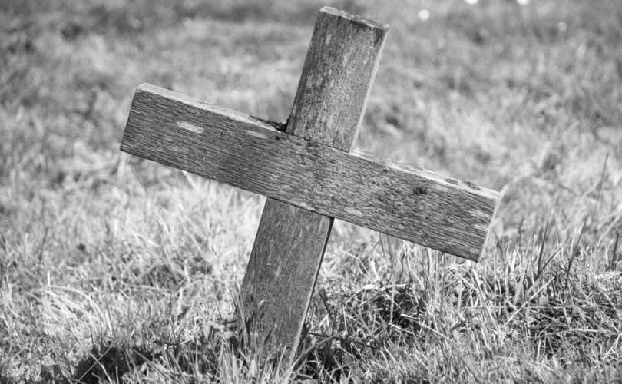
Public Health Act Funerals
Known as pauper’s or welfare funerals
Simple service before being cremated or buried in a communal grave
Often body is transported in a van rather than a hearse
Service conducted in a vacant slot, such as early morning at a local crematorium or cemetery chapel
Notes:
SLIDE 13: PUBLIC HEALTH ACT FUNERALS
Public Health Act funerals are often known as Paupers Funerals or Welfare Funerals.
Councils have a statutory duty under the provisions of Section 46 of the Public Health (Control of Disease) Act 1984 to undertake the funeral or the cremation of a body of any person who has died or is found dead in their borough where it is established after investigation that there is no alternative course of action.
If the deceased person died in a hospital managed by a NHS Hospital Trust then the Bereavement Officer of the hospital in which the person died will assume responsibility for the funeral, and a Hospital Contract funeral will be arranged.
A deceased person is usually cremated or buried in a simple service.

Slide 12
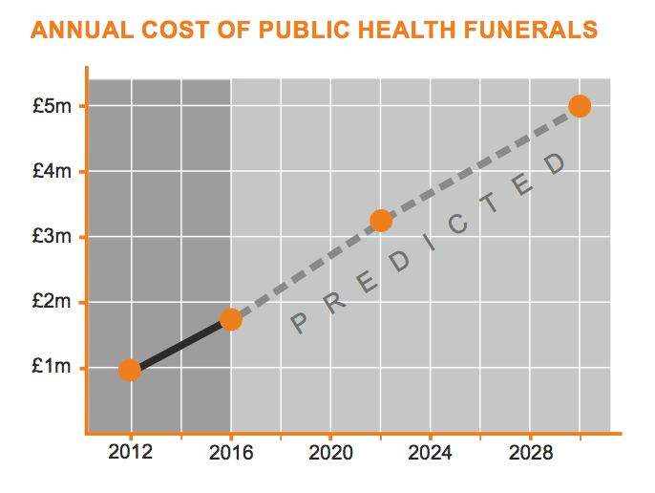
The Annual Cost of PHA Funerals
Costs have risen 30% to £1.7m in the past four years alone
If trend continues this could be £3.5m by 2022 and £5m by 2030
Notes:
SLIDE 14: THE ANNUAL COST OF PHA FUNERALS
A report last year showed that the cost to local councils of so-called "paupers' funerals" has risen almost 30% to £1.7m in the past four years.
The number of these funerals has also risen by 11%, a Freedom of Information request by BBC Local Radio revealed.
As part of the research, 436 councils in the UK were asked questions about how many public health funerals they carry out and how much these cost them.
Of the 409 who are responsible for public health funerals, 300 gave full responses.
The results show councils carried out 2,580 public health funerals in 12 months spanning 2013-14, which represents a small fraction of the 500,000 or so people who die in the UK each year.
Overall, north-west England has the greatest number of public health funerals, followed by London.
The biggest increase was in south-east England where there was a rise of 24% since 2009-10, followed by Scotland, where the number went up by 21%. It also rose significantly in the West Midlands and Wales.
However, the largest rise in cost was in south-west England - where public health funerals cost councils 39% more now than they did four years ago. Scotland has also seen a sharp rise in cost, while the north-east of England has seen a similarly steep increase.
After some funeral costs were recovered, the cost to councils for those funerals was £1,719,329 - an increase of 28% in the past four years.
The average cost of a funeral now stands at £3,700, according to the Royal London Insurance company - and even a public health funeral with no frills can cost around £1,000.

Slide 13
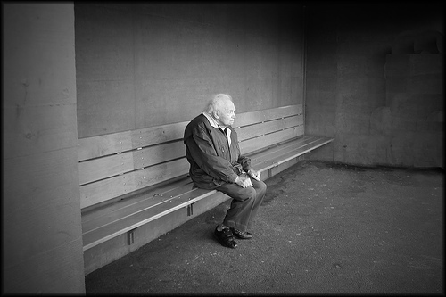
Why?
Increasing number of bereaved families are struggling to pay for funerals. According to Royal London, 100,000 of 500,000 families each year in the UK
More and more people are living longer and dying alone
Notes:
SLIDE 15: WHY?
Why is this happening? There have been a number of articles examining this trend and many suggestions as to why this is happening.
One such article in The Gazette stated that:
Increasing numbers of bereaved families are struggling to pay for funerals, as the cost of laying someone to rest continues to spiral.
Compared with the 2 years leading up to the 2010 general election, local authorities in the north east of England spent 78% more on funerals for families who did not have the money to bury their loved ones. Families can apply for part-funding from the council to cover funeral bills, or the council will meet the full cost if the deceased’s estate does not cover the fees.
One authority faced a 100% increase in how much they paid out to cover funerals, either in full, or as a contribution to costs:
South Tyneside Council went from spending £500 on 2 funerals before the 2010 General Election, to 11 funerals costing £7,000 in 2013/14
County Durham saw its costs double, as the cost of 6 funerals and contributions was £3,015 in 2008/09, but rose to £7,386 in 2013/14
In addition, a report by insurance company Royal London showed that 100,000 of the 500,000 families bereaved each year in the UK struggle to afford the cost of a funeral, with resulting debt averaging £1,300. The average funeral in the UK now costs around £3,551, a substantial increase over the course of the last decade.
Numerous complex factors are thought to be behind this increase in need for council-funded funerals (public health funerals).
The South Shields MP Emma Lewell-Buck told MPs in parliament that hundreds more could face the “tragedy of funeral poverty” due to an ageing population and rising levels of debt. She said the situation had even led to low-income households using payday loan companies, and selling possessions, to fund a funeral.
“One in five families do not have the money to give their loved ones the funeral they deserve.
[new notes]
Bullet 1
Anecdotal evidence suggests that with funeral costs going up, families may struggle and are turning to local authorities for support.
People on low incomes can apply for assistance through the Social Fund, which covers the full costs of burial or cremation, and up to £700 in funeral director's fees.
They can be put off by the complexity of that process, though, and there is no guarantee that an application will succeed.
Even if it did succeed, the £700 funding amount had not changed for a decade - while funeral costs had gone up by more than inflation.
Councillor Izzi Seccombe, of the LGA's community wellbeing board, said: "It is a sad fact that there are thousands of people across the country with no family or friends to arrange, attend or pay for their funeral. Nobody should find themselves in that position."
[Simonnne you may prefer to add your own anecdotal story here] Sandra Evans, assistant director of bereavement services at Cardiff City Council, searched the home of Sandra Horner, a former head teacher who was 67 when she died - it is discovered she was divorced and had no children.
"It's always quite sad. You see how a person lived, and you come across letters and photographs... a little insight into what their life was like," says Ms Evans.
With no close family still alive, it is the council that will have to arrange and pay for Sandra Horner's cremation.
Ms Evans says public health funerals used to be a last resort - used mainly for the homeless - but they are becoming more common.
Sandra Horner was cremated at a simple service attended by about 12 of her friends.
Bullet 2
People are living longer and dying alone.

Slide 14
Causes of Loneliness
Bereavement (those at risk: unmarried/widowed without children or siblings)
Psychological problems, phobias, paranoia
Personality disorders; relationships with people too challenging
Family feuds / abuse
Alcoholism, drug/substance abuse
Notes:
Slide 16 – Causes of loneliness
According to psychologist Stuart Whomsley, in terms of individual and family factors the most basic cause is bereavement. One group at particularly risk are the unmarried or widowed without children or siblings.
Physical impairments, a factor which increases with age, also increase the risk of social isolation. Psychological problems such as social phobia and paranoia can lead to a person isolating themselves. People with conditions such as personality disorders may find relationships with people too challenging and distressing and may withdraw from the social world. Simonne anecdotal story here – lady in the van?]
Then there are the family feuds, which may be over very little substance, but can over the years solidify into a family schism.
Not to mention alcoholism, drug and substance abuse can destroy relationships and cause someone to end up living a solitary existence.

Slide 15

Social Isolation
Changes in modern society
We live in nuclear family units, often large distances away from our extended family and friends
Growing reliance on social technology rather than face to face interaction is thought to make us feel more isolated
Notes:
Slide 17 – Social Isolation
Social isolation is, as one might expect, the separation of the individual from a social connectedness. It can occur for a number of reasons that relate to the individual, their family and to their environment.
Important environmental factors that contribute to a person becoming socially isolated include the physical environment where they live; from the small scale, such as street lighting quality to the larger scale of whether houses are occupied by a more settled or a transient set of residents. Access to public transport and crime rate can also be important in how socially isolated people are, particularly for older adults. A sense of community reducers the risk of social isolation and explains why people can become more socially isolated in urban areas than rural ones.
Loneliness is not the same as social isolation, though obviously there is a strong relationship between the two. Loneliness is the subjective experience of not feeling connected to people. Robin Williams famously commented on this thus:
“I used to think that the worst thing in life was to end up alone. It's not. The worst thing in life is to end up with people who make you feel alone.”
People can feel lonely even if they have some social contact, so not socially isolated, but when they have no significant other. Or, in contrast, someone with a partner who has health problems and for whom they are the carer can also feel lonely as their social contacts diminish.
These factors of social isolation and loneliness can in different combinations be the pathway to both poor health and a premature death, and to a person dying alone, or totally separated from any known relatives.
Bullet 1
Loneliness is an increasing problem in modern life. The Church Urban Fund and the Church of England found a rise of 10 per cent in the last three years in clergy members who felt that social isolation was a major problem in their local area. Another survey by the Mental Health Foundation found that in the UK one in ten of us feels lonely often and 48 per cent of people think we are getting lonelier in general.
Bullet 2 & 3
So why are we getting lonelier? According to Dr Rebecca Harris is a Psychology lecturer at the University of Bolton, changes in modern society are considered to be the cause. We live in nuclear family units, often living large distances away from our extended family and friends, and our growing reliance on social technology rather than face to face interaction is thought to be making us feel more isolated. It means we feel less connected to others and our relationships are becoming more superficial and less rewarding.
We are social animals and need to feel that we "belong" to others and feel connected to one another. Social pain is as real a sensation for us as physical pain; researchers have shown that loneliness and rejection activates the same parts of the brain as physical pain.
Loneliness affects all of us at some point in our lives. Relocating to a new area, losing a loved one, and starting a course at university are all key times when people feel lonely. Research suggests that this experience of loneliness is useful to us as it motivates us to reconnect with others and to seek out new friendships to reduce the "social pain" that we feel. But for some, when reconnection is not easy or not possible, if a person is socially isolated, people can remain in this uncomfortable loneliness state for a number of years. Reports vary but typical numbers of people experiencing loneliness in this prolonged way range from three to 30 per cent.
[Perhaps talk about how its interesting how our Dublin office see a very different story because society there is still very much close?]

Slide 16
Social Isolation
Recent research indicates that this may be the next biggest public health issue on par with obesity and substance abuse
Mental Health Foundation found that in the UK one in ten of us feels lonely often and 48% of people think we are getting lonelier in general.
Britain has even been voted the loneliness capital of Europe
Notes:
Slide 18 – Social Isolation
Point 1
Modern life is making us lonelier, and recent research indicates that this may be the next biggest public health issue on par with obesity and substance abuse. A recent review of studies indicates that loneliness increases mortality risk by 26%.
Point 2
For those that experience loneliness for a long time, research has shown that this impacts on their health in a greater way than smoking 15 cigarettes a day or being obese. Loneliness has also been linked to poor mental health. In a survey by Mental Health Foundation, more than a third of people surveyed had felt depressed as a result of feeling lonely.
There are a number of myths regarding who experiences loneliness. Certainly all of us feel it from time to time, but it is commonly known that loneliness particularly affects the elderly who may be socially isolated due to decreased mobility and loss of friends and partners. But it is not often acknowledged that loneliness also effects people at all ages, including children, and is particularly prevalent in the teenage years. Studies have shown that between 20 and 80 per cent of adolescents report feeling lonely often, which is compared to 40 to 50 per cent in an elderly population.
Another myth is that loneliness is typically associated with being alone, but it also effects people when they are surrounded by others and well-connected socially. This is because loneliness is about the quality rather than the quantity of relationships that we have, so a person may have a lot of friends but still find that their needs for social contact are not met.
What can we do to reduce loneliness? This question has not been an easy one for researchers to answer, as common sense approaches - such as increasing opportunities to make friends - do not always result in reducing a person's loneliness. Certainly where people feel lonely because they are social isolated, ways to reconnect, when found, can be used by the person to reduce their loneliness. In a recent study, loneliness was reduced in older people in residential care when they were given training in social media use so they could remain in contact with family and loved ones. But it seems that it is not as simple as this, because offering such opportunities does not uniformly reduce loneliness.
In a recent review, researchers found that strategies to reduce loneliness that target negative thought processes were the most successful. So it seems that for some lonely people, reducing social isolation and helping them link up with others reduces loneliness. But those who have been lonely for a number of years will have anxiety about making new friends, they may be distrustful of others and feel low about their own social skills. They need support to change their view of themselves, and how they feel others will react to them.
Britain has even been voted the loneliness capital of Europe, and at Finders International, although we can only witness and not solve the problems of society, we can try and support it as best we can. This is why we have launched the Finders International Funeral Fund.

Slide 17
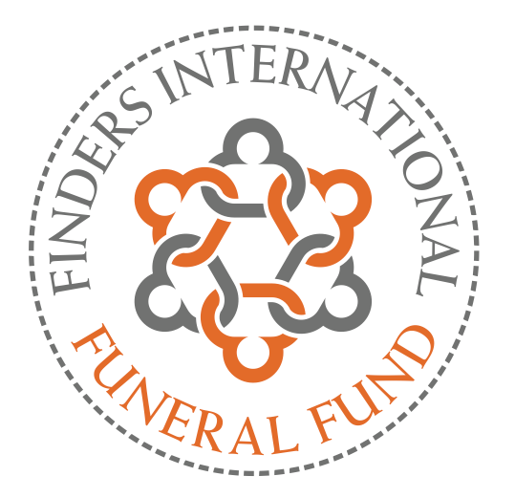
The Launch of FIFF
Helping to cover the cost of Public Health Act and Hospital funerals
LA’s or NHS trusts can now ask Finders International for a subsidy payment towards the cost of PHA funerals where there are genuinely no next of kin.
Notes:
SLIDE 19: THE LAUNCH OF FIFF
Today is a special day for us in that we are very proud to be officially launching the Finders International Funeral Fund (or FIFF). You have leaflets about this in your bags, but please come to our stand for further information about the fund and how it can assist local authorities and hospitals.
Local Authorities or NHS trusts can now ask Finders International for a subsidy payment towards the cost of Public Health Act (PHA) funerals. These will be cases where there genuinely are no known next of kin (rather than next of kin simply refusing to pay) and Finders will carry out the research to confirm this.
These are cases where there are no apparent next of kin to inherit the Estate, and the Estate is described as “Bona Vacantia”. As no family are thought to exist, there is no-one for the local authority to approach for reimbursement of the funeral costs, and this is where Finders can assist.

Slide 18
Giving Back To The Community
Finders International will transfer a percentage of the commission it earns from our next of kin tracing work to the fund.
To launch the fund, Finders International will deposit an initial donation of £20,000 and pledge to donate a minimum of £10,000 every subsequent year.
Notes:
SLIDE 20: GIVING BACK TO THE COMMUNITY
At Finders International giving back to the community is an important part of our ethos and culture as an ethical organisation. This is why we have decided to establish the Finders International Funeral Fund.
Finders will transfer a percentage of the commission we earn from our next of kin tracing to this Fund. To launch the find, Finders International will deposit an initial donation of £20,000 and a pledge to donate a minimum of £10,000 each subsequent year.

Slide 19
Adding Value
If no next of kin are found, Finders will:
Let the Deceased’s neighbours, colleagues, friends and other people we contact know about the funeral in case they wish to attend
When appropriate Finders may also contact the media and post alerts on the internet via social media
When possible a representative from Finders International may attend the funeral. Our Funeral Fund could also be used to help pay for a suitable memorial.
Notes:
SLIDE 21: ADDING VALUE
In cases where there are no next of kin, Finders will let the Deceased’s neighbours, colleagues and friends know about the funeral in case they wish to attend.
Where appropriate Finders will contact the media and post alerts on the internet via social media.
A good example of positive media exposure occurred recently following a story where the Deceased was mentioned in an article in a local paper. As an ex-military man who had served his country in the second world war, this story naturally attracted attention when he passed away, seemingly alone with a PHA funeral being planned for him.
After circulation on social media interest in his case grew and grew to appoint where there were a large number of attendees at the funeral, who also arranged between them, to cover the cost of the funeral for the local authority.

Slide 20

How FIFF Will Help You
We can confirm that there are no next of kin, which saves you time and effort
We will grant a payment which could fund the funeral completely or partially
Notes:
SLIDE 22 : HOW FIFF WILL HELP YOU
Our aim, when working with local authorities and NHS Trusts is to locate next of kin. In cases where there are proven to be no next of kin, we can confirm this for you quickly, saving you time and effort. This search service is completely free of charge.
If Finders prove that there are no next of kin to approach regarding the funeral, or entitled to share in the Estate, then these are the cases that are eligible for Finders International Funeral Fund. We will, along with our Report, recommend that you apply for a partial or complete payment towards the Public Health Act Funeral that will need to be conducted.

Slide 21
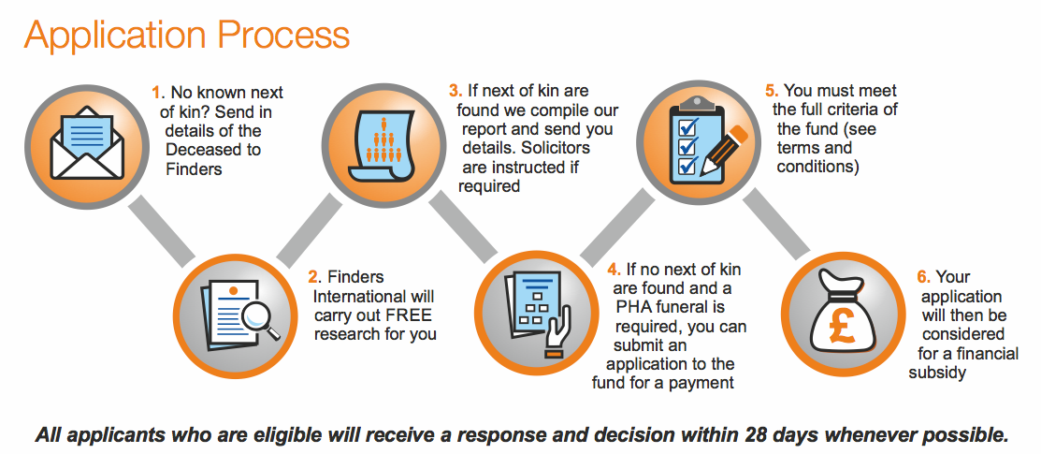
Application Process
Notes:
SLIDE 23: APPLICATION PROCESS
So, how does this work in practise?
The local authority (or whatever public body wishes to send cases to us), can let us know when they have a case where a resident has died supposedly leaving no next of kin.
Finders will carry out a free search service to locate next of kin, and if next of kin are identified we will follow the process already described to ensure that the council are put in touch with the next of kin, and the estate administration process is begun.
If it is proved that the family has died out, for example, the Deceased may have been a bachelor, leaving no children, and an only child himself. His parents may have both pre-deceased and they may have been only children, or had siblings that have also died leaving no issue; then this would be a case that would be described as being Bona Vacantia, as there is no one who can legally inherit the Estate according to the intestacy rules of England and Wales.
Once this has been proved, we will report back to you, again free of charge, to let you know that this is the situation. The local authority (or publics sector body who has requested the research) will then be able to apply to Finders International Funeral Fund for a payment towards the funeral costs.
A set of simple criteria (which are included in our Terms and Conditions) must be met, and if so, each application will be considered, and an answer provided to you PROMPTLY
(IF QUESTIONED, WE ALLOW 28 DAYS TO REPSOND AS SOME CASES NEED TO BE RESEARCHED FURTHER TO ESTABLISH WHETHER OR NOT NOK ACTUALLY EXIST OR WHETHER THE CASE IS SUITABLE FOR FUNDING)

Slide 22

Our Promise
Whether or not the Deceased has any assets is not relevant, we work on cases equally regardless of estate value
Every case submitted by a local authority or NHS trust will be fully researched for FREE as a matter of protocol
Notes:
SLIDE 24 Our Promise
Our promise to the public sector is that we will carry out research free of charge, in every case referred to us, whether the Estate has assets or not.
Our aim is that family members can be informed quickly and sensitively about a relatives death, and given the opportunity to attend the funeral, and take on the funeral where possible. Administration tasks formerly overloading local authorities are eased, and costs are lowered by referring this research to us.
Estates are therefore wound quicker than before, and outstanding local authority costs are settled swiftly where possible.

Slide 23
Testimonials
“Thank you so much for your informative input towards this case and the speed of which you responded to our department’s request” Croydon Council
“Thank you so much for your help. This has been an excellent service and one I have already passed to colleagues who are looking for next of kin” Blackpool Council
“Many thanks, you have provided an excellent service to me and kept me updated throughout your investigations which I very much appreciated” Blackburn, Hyndburn & Ribble Valley
“The Finders Next of Kin Tracing Service offered a quick and free way to fulfill Bona Vacantia’s requirements to make reasonable efforts to locate blood relatives to administer any residual estate following a public assisted funeral.” Worthing Borough Council
Notes:
SLIDE 25: TESTIMONIALS
We have many testimonials both on our website and in our literature from local authorities and NHS Trusts who have used our services. A few are shown here on our slide, but if you would like more information, please visit our stand to collect our literature and discuss these in greater depth.
We are currently assisting numerous local authorities and NHS Trusts across the country, and would be delighted to discuss how we can help your authority too, if we are not doing so already.

Slide 24
Let Us Help You
To find out more about our work or FIFF please contact us today
UK Freephone 0800 085 8796
Phones answered 24/7 by UK personnel
www.findersinternational.co.uk
fiff@findersinternational.co.uk
Advice is always free of charge or obligation
Notes:
SLIDE 26: LET US HELP YOU
If you would like to visit our stand at XX we are here all day today, or alternatively, you might like to visit our website where more details about our work and FIFF are explained.
Thank you for listening.
Good night Birmingham, we love you!!

