Slide 1

Welfare Reforms

Slide 2
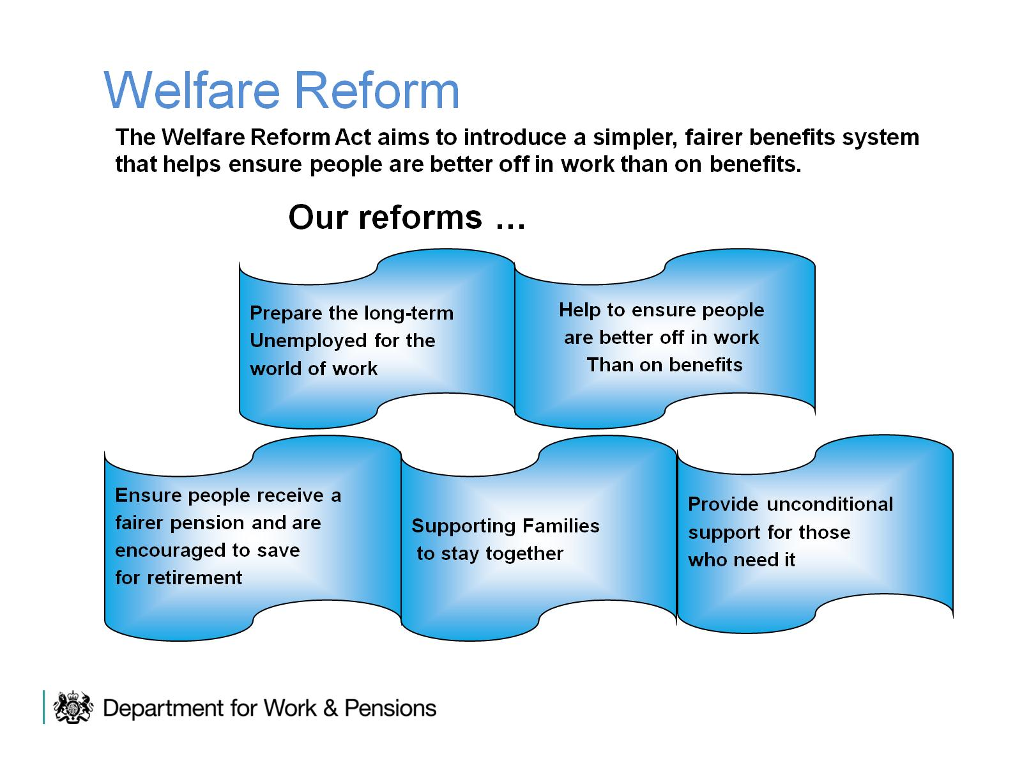
Welfare Reform

Slide 3
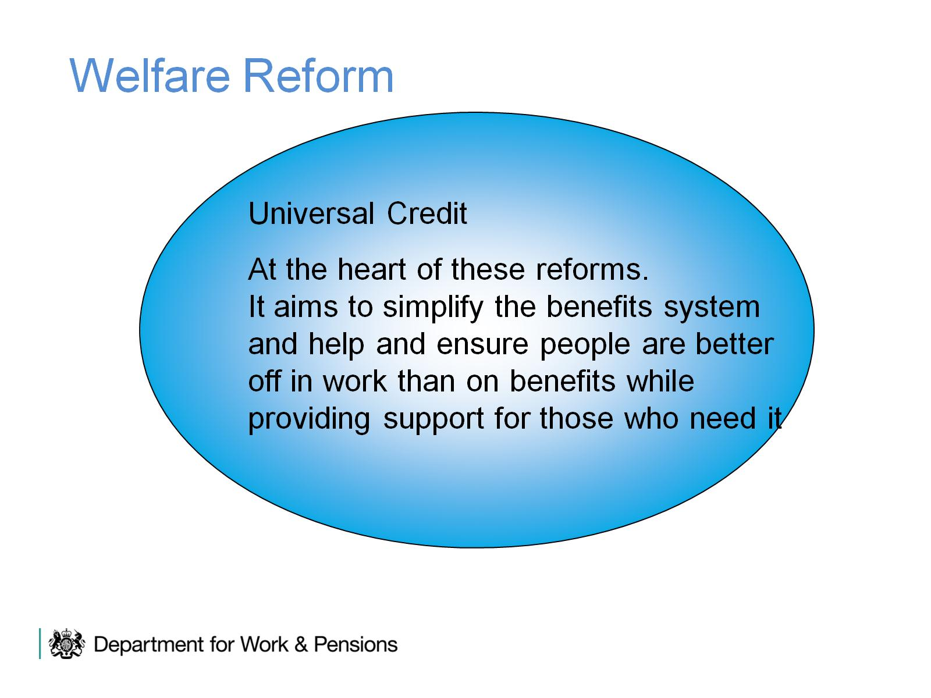
Welfare Reform

Slide 4
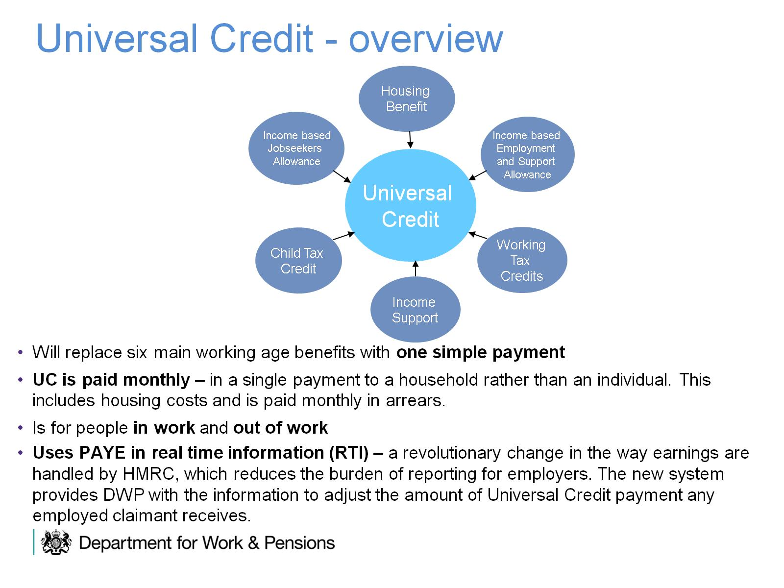
Universal Credit - overview

Slide 5
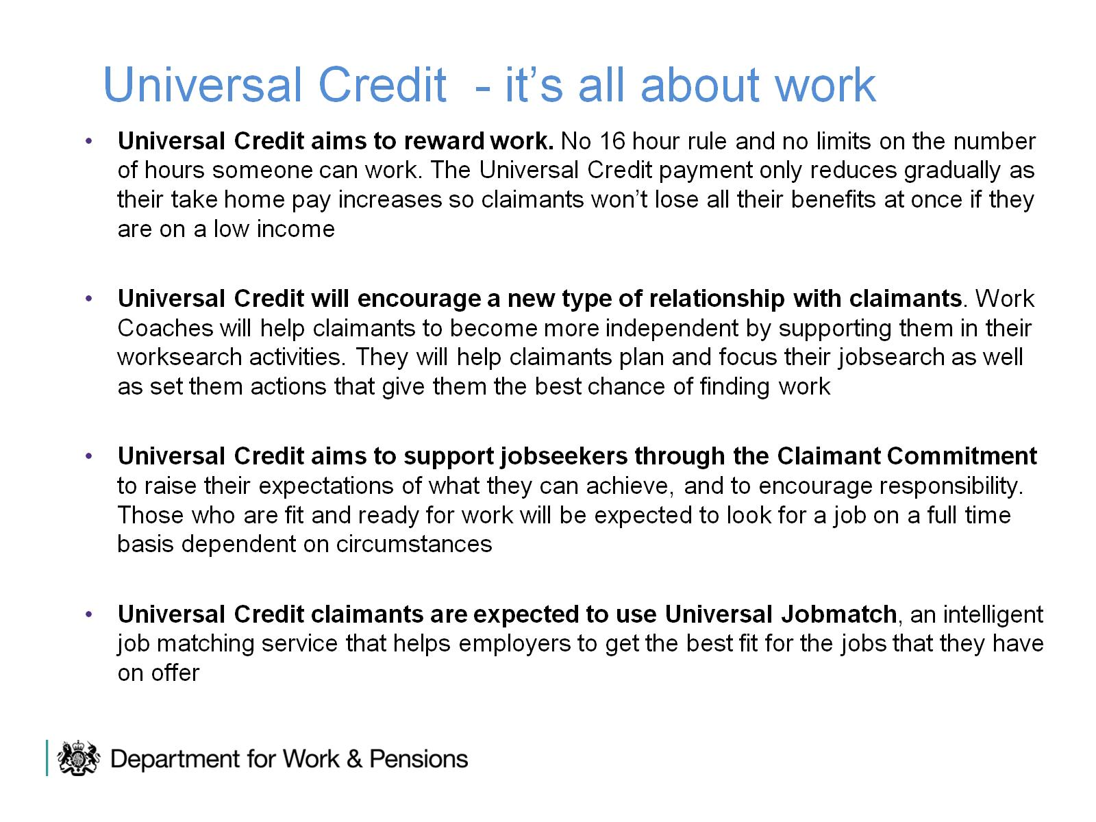
Universal Credit - it’s all about work

Slide 6
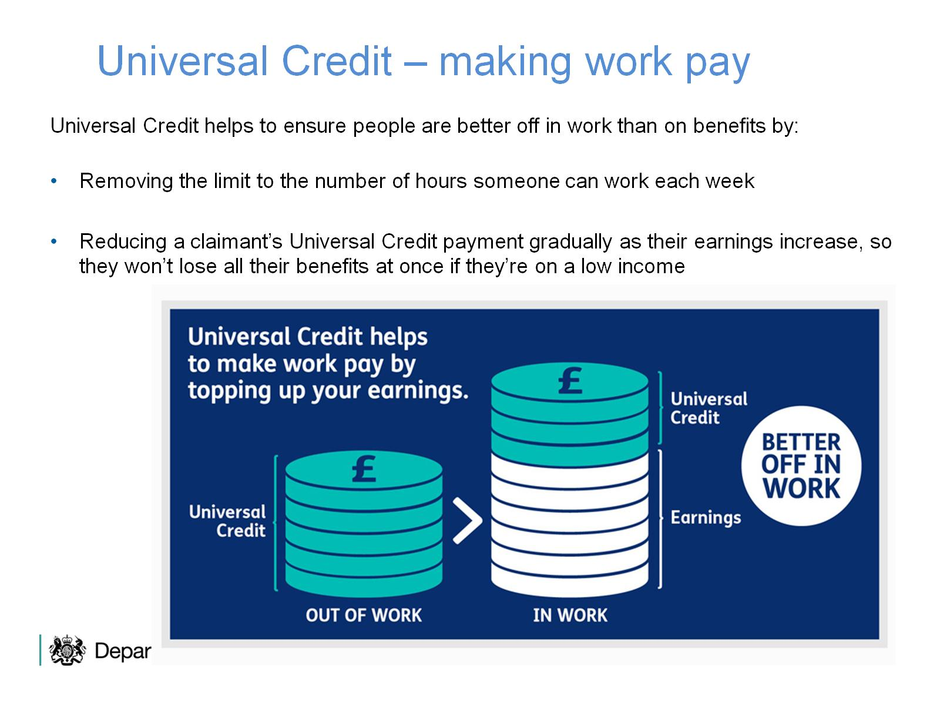
Universal Credit – making work pay

Slide 7
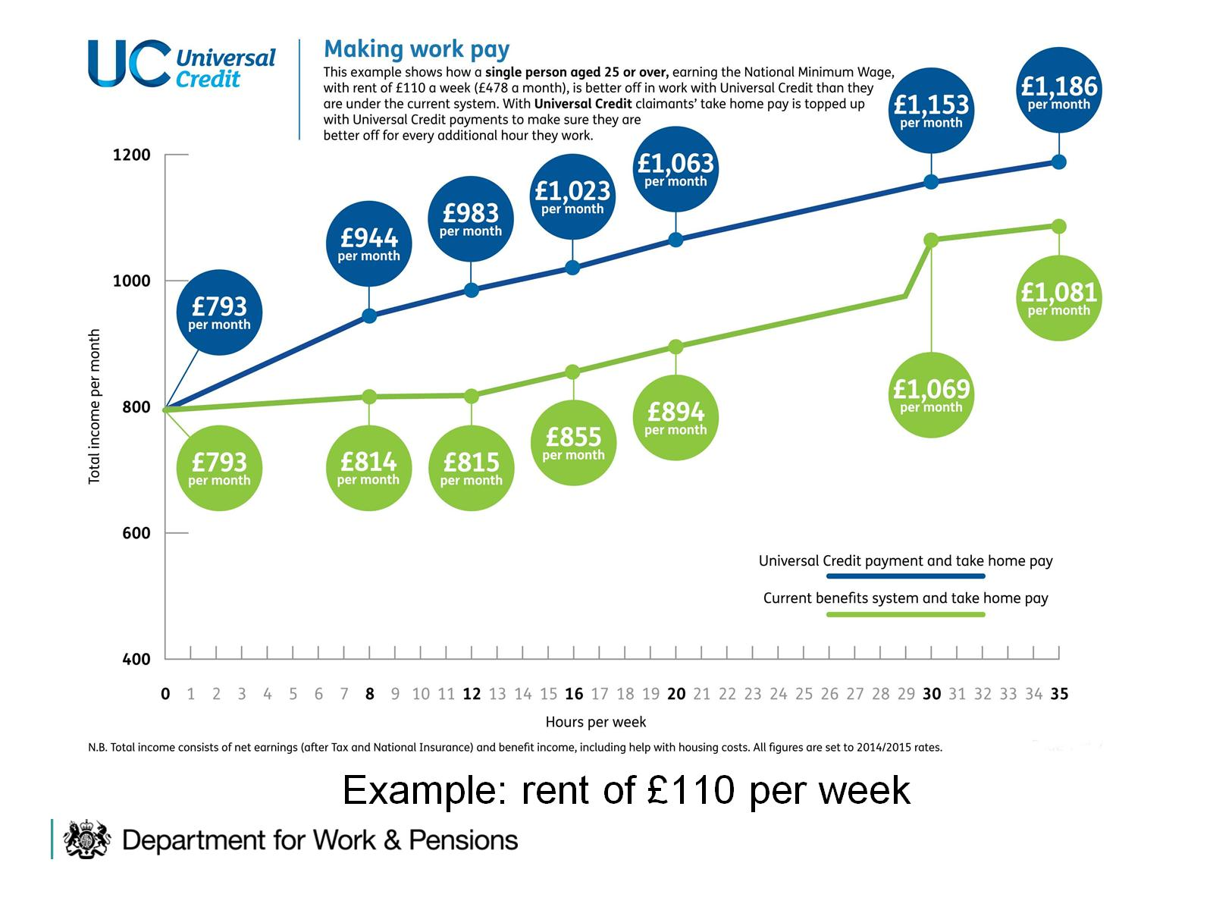
Example: rent of £110 per week

Slide 8
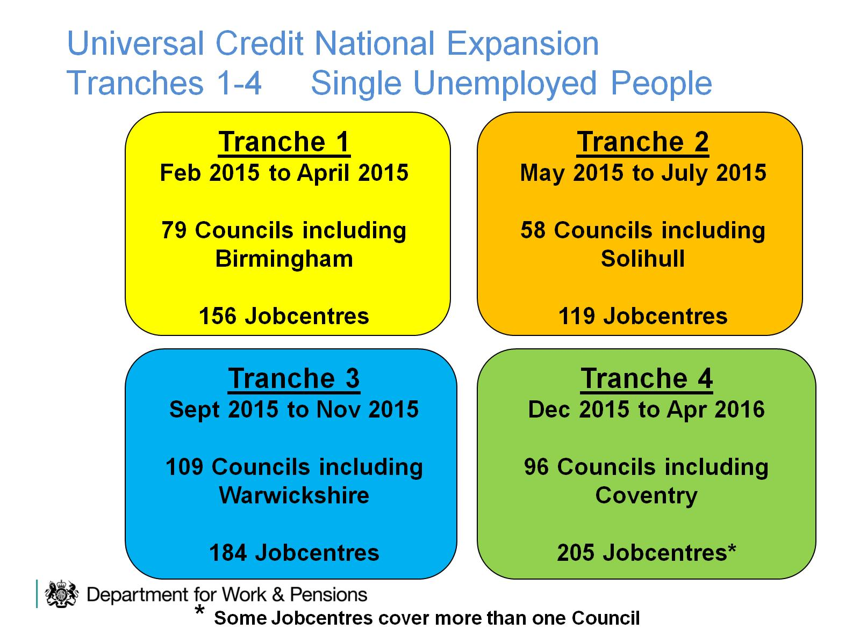
Universal Credit National Expansion Tranches 1-4 Single Unemployed People

Slide 9
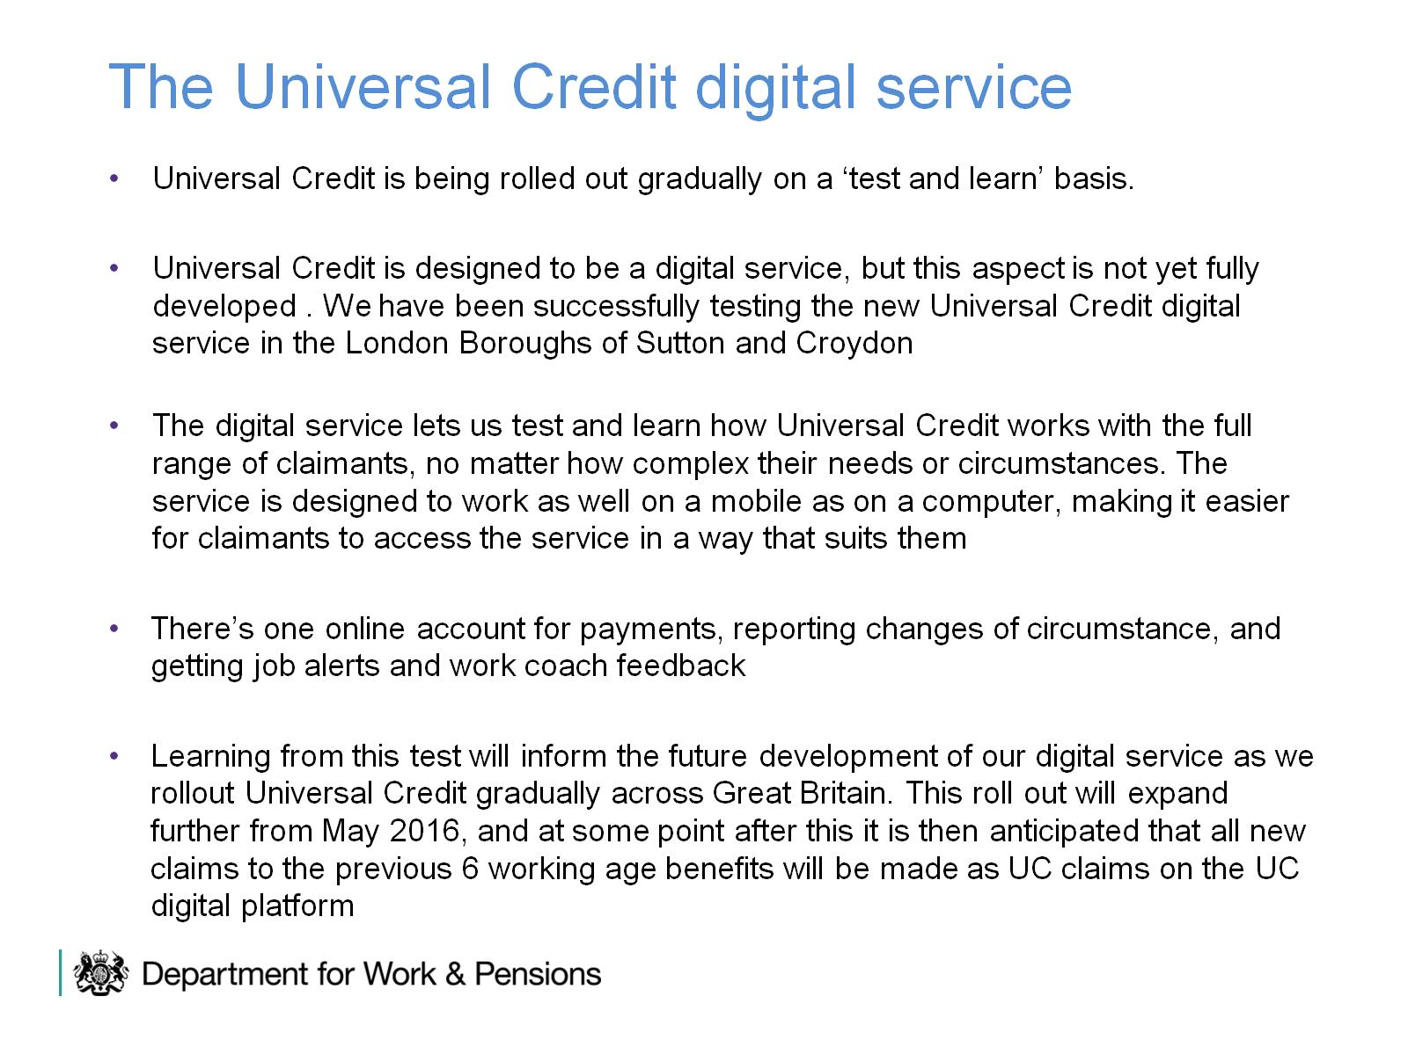
The Universal Credit digital service

Slide 10
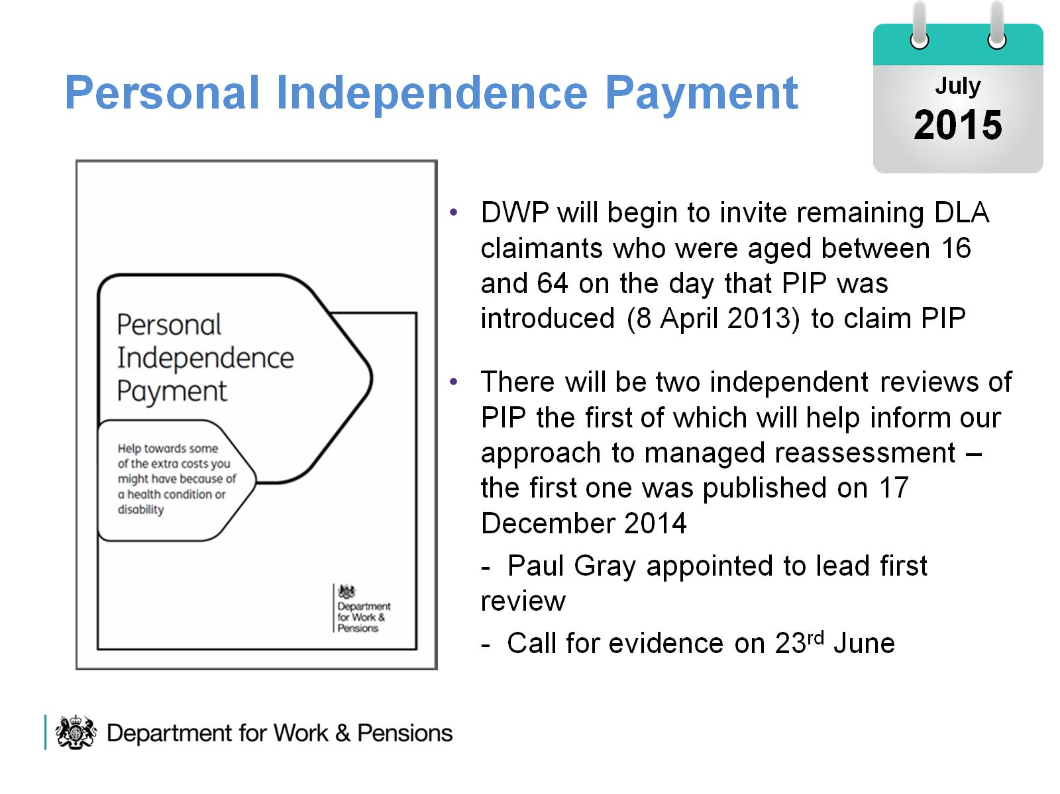
Personal Independence Payment

Slide 11
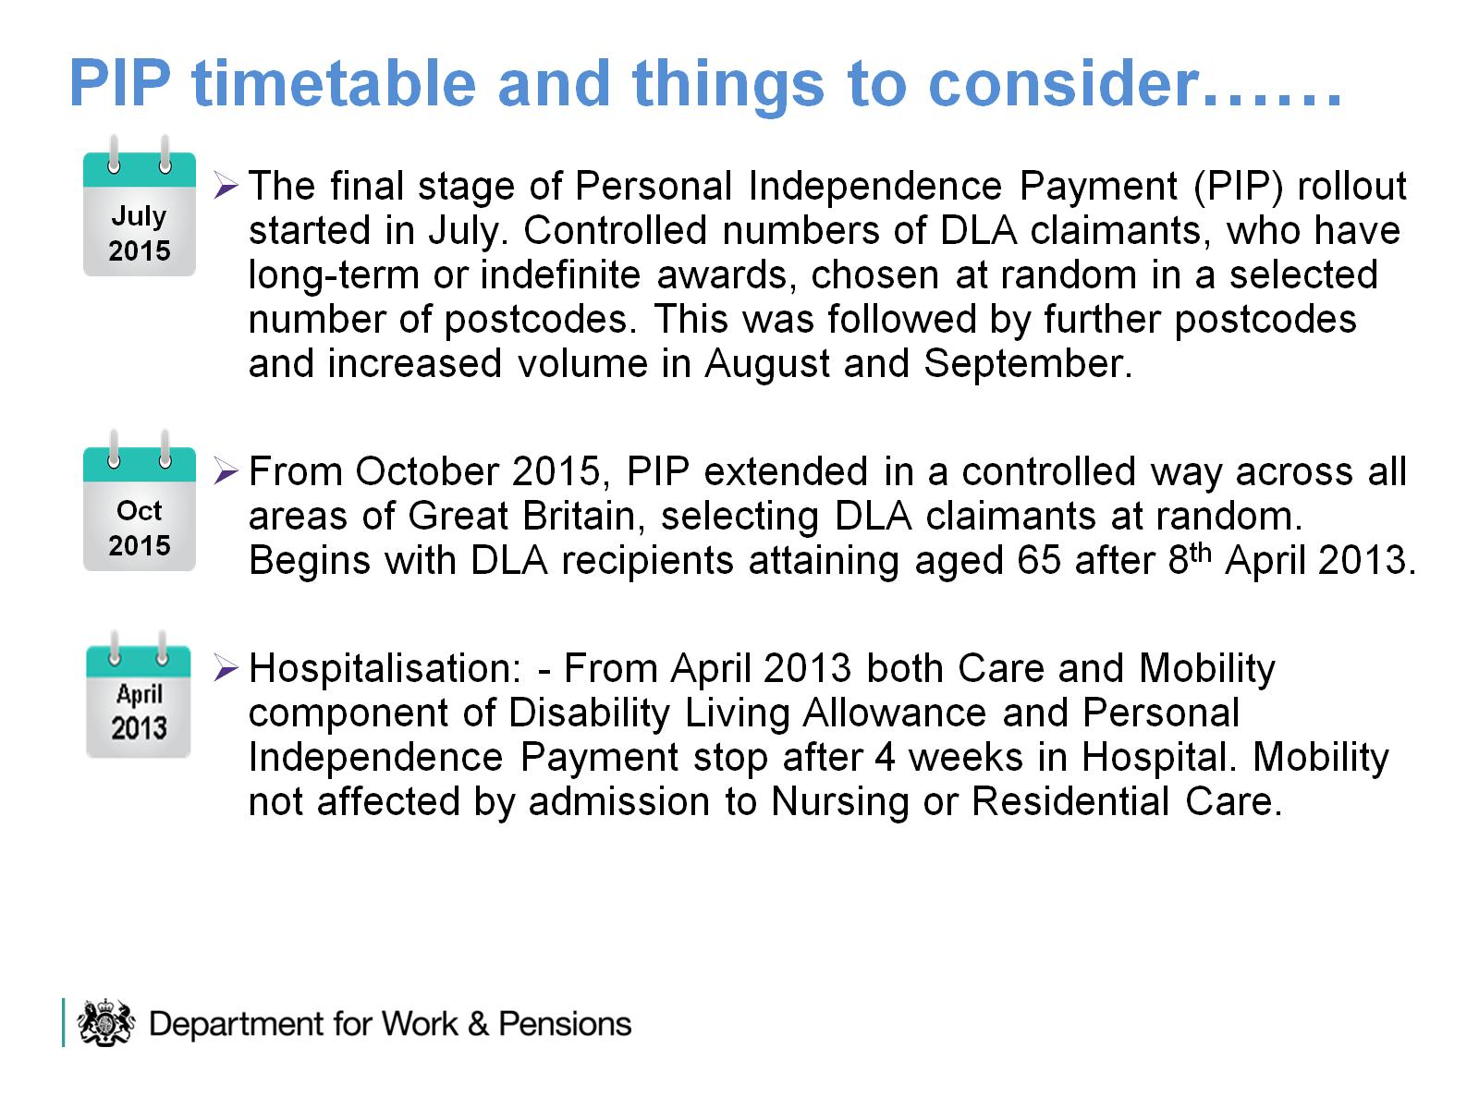
PIP timetable and things to consider……

Slide 12

New State Pension

Slide 13
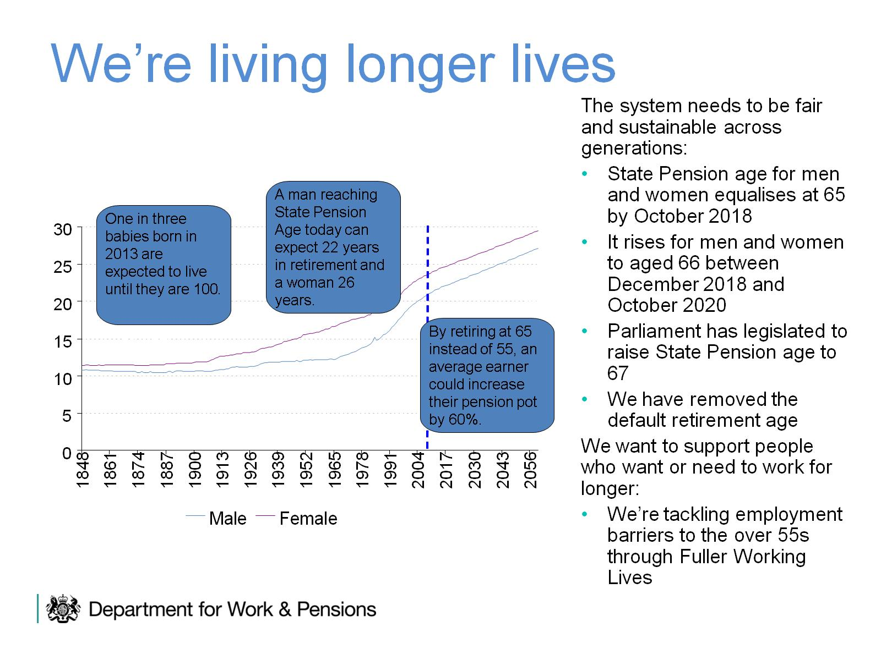

Slide 14

We’re not saving enough

Slide 15
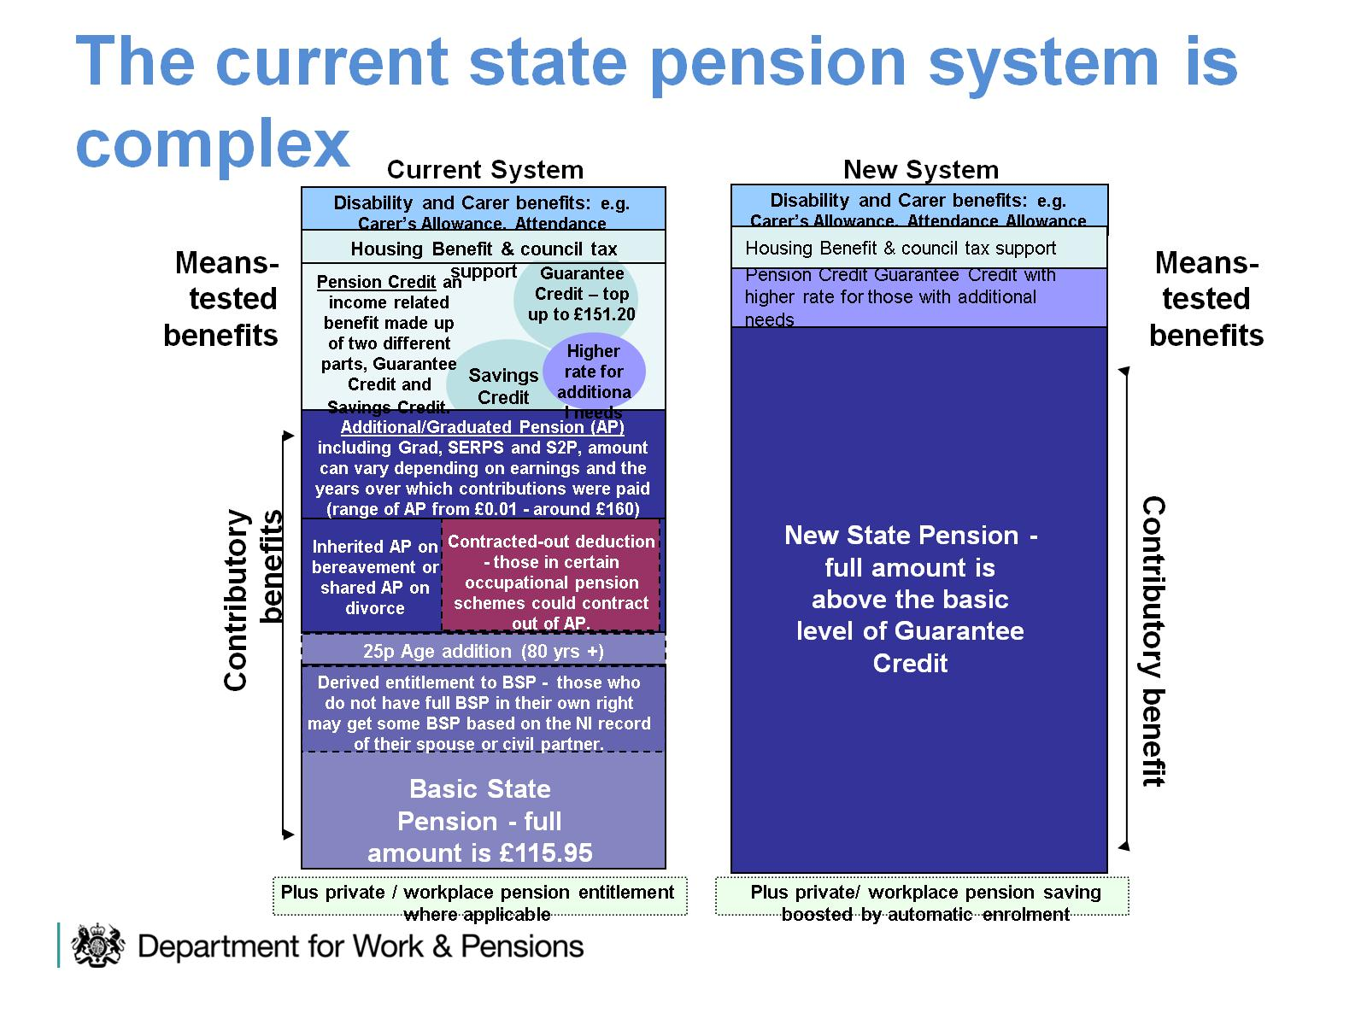

Slide 16
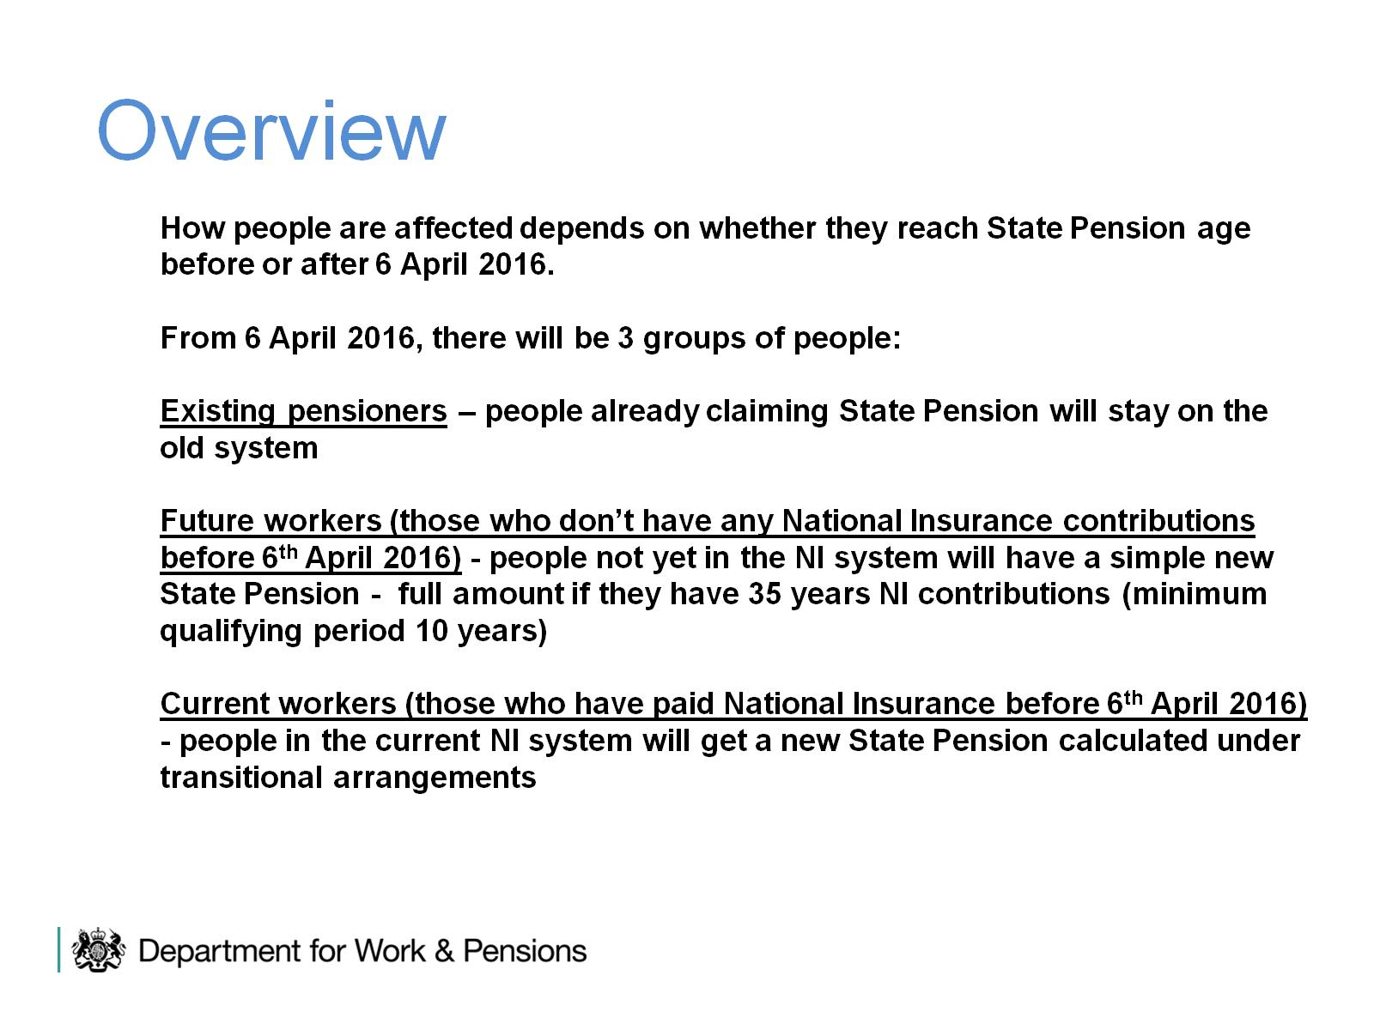

Slide 17
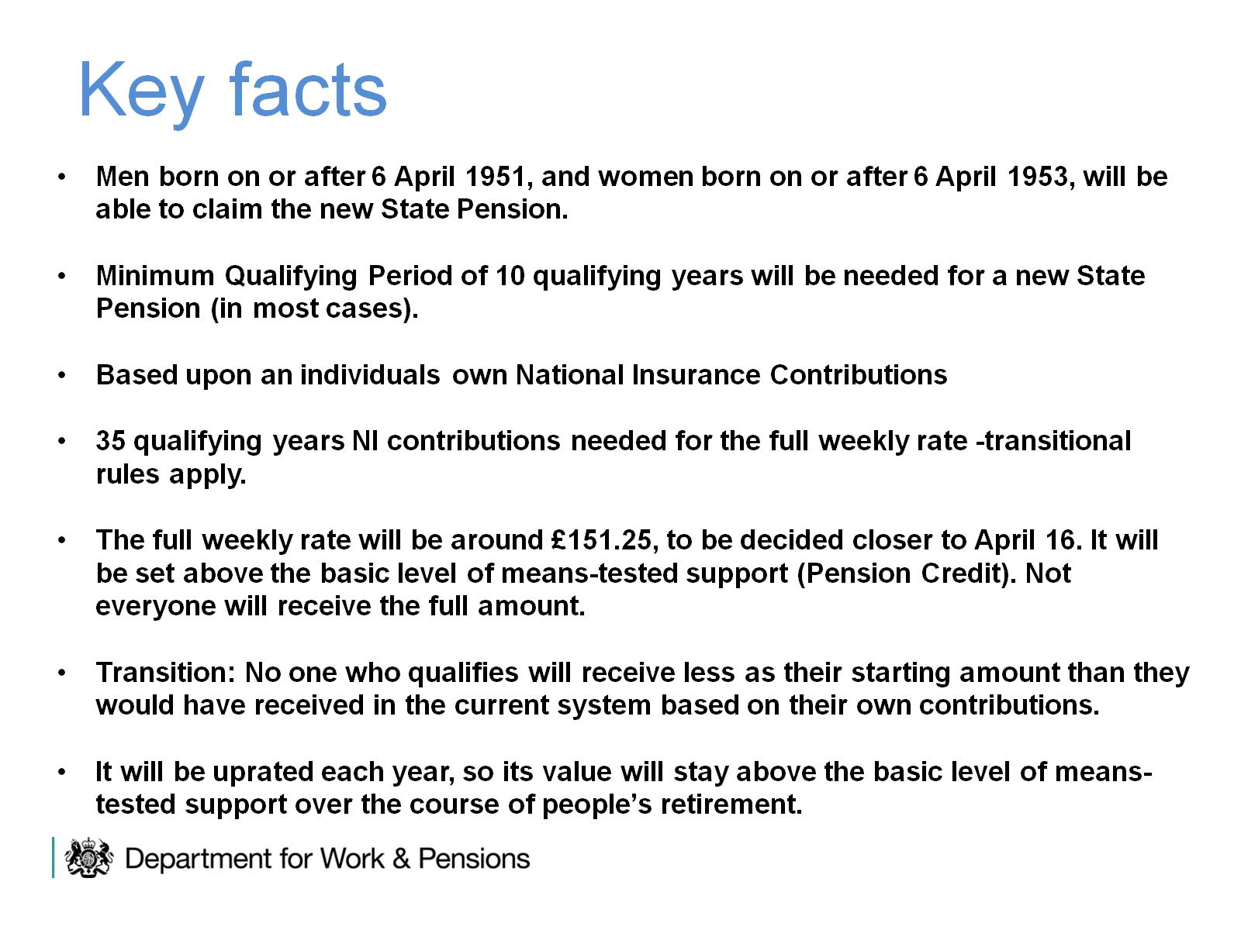

Slide 18
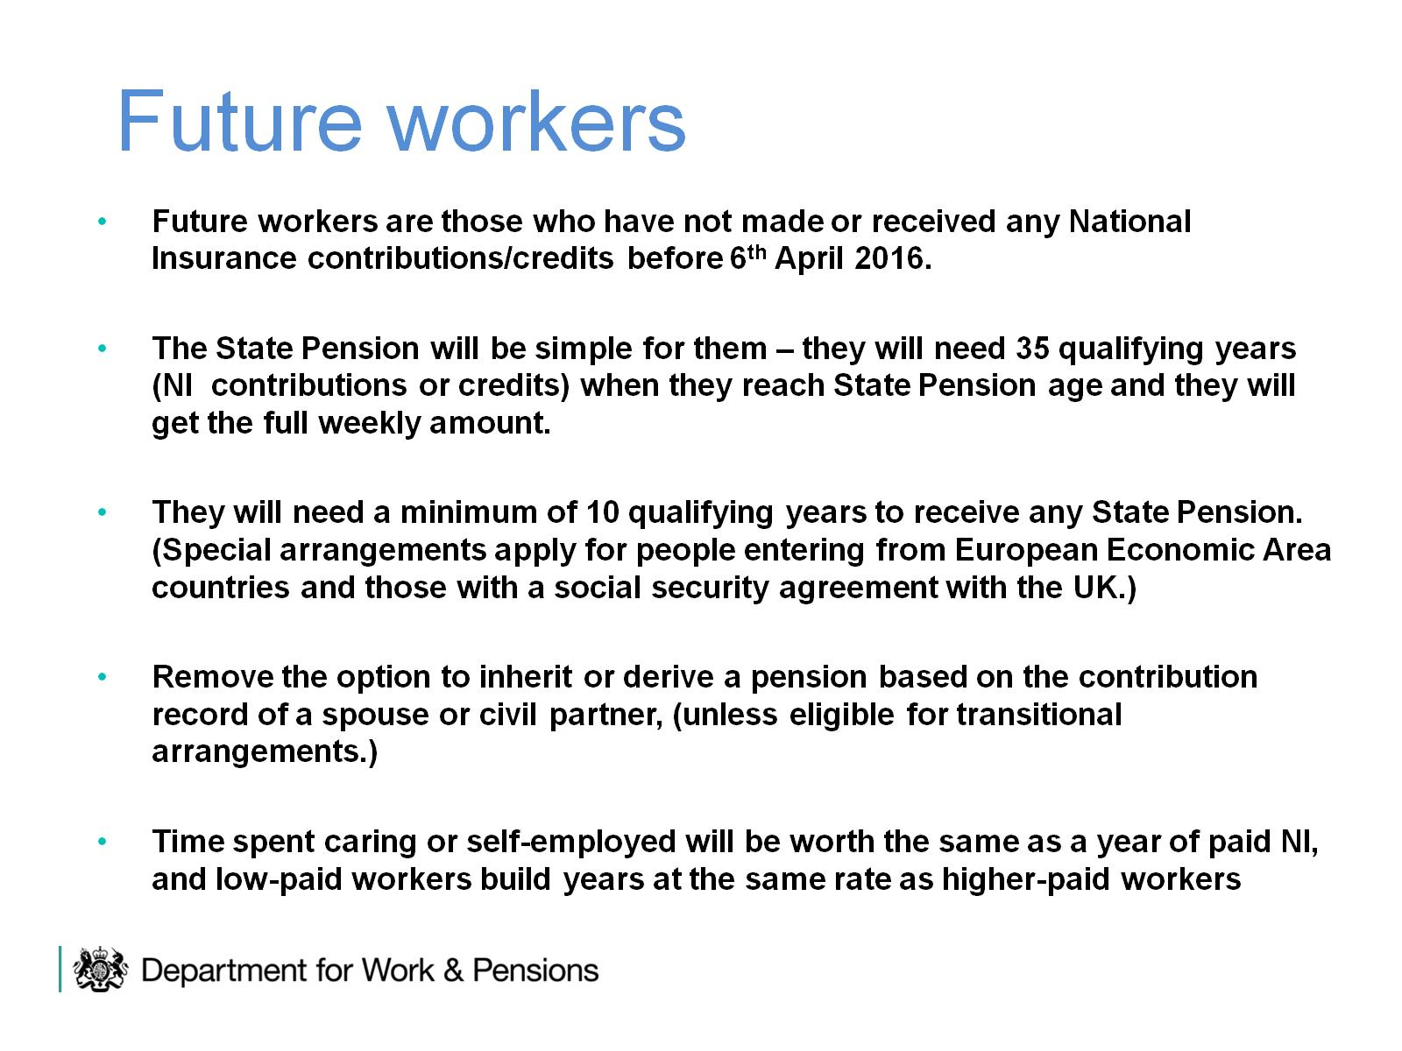
Future workers

Slide 19

State Pension Top Up

Slide 20
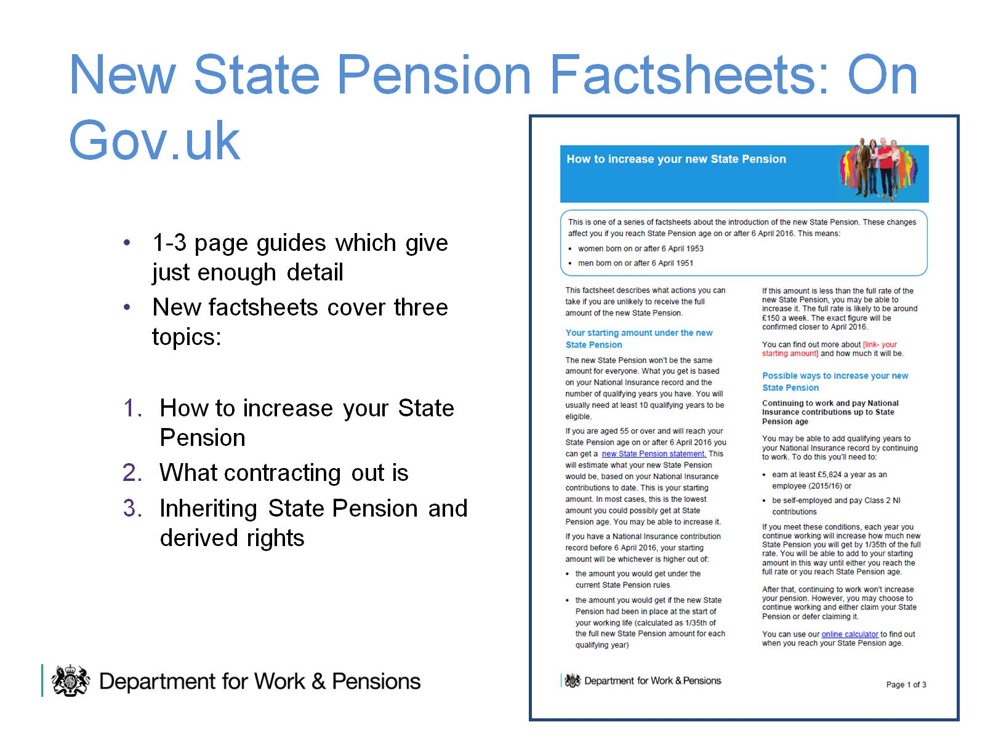
New State Pension Factsheets: On Gov.uk

