Slide 1

Why Social Care Matters
Harold Bodmer, ADASS President 16/17

Slide 2
Context for Adult Social Care
Demand for social care
Greater recognition for social care than ever before
The Care Act
Personalisation and Personal Care budgets
Integration now a clear policy intention
Sustainability and Transformation Plans, place based
High profile for dementia
Transforming Care
Higher profile for mental health

Slide 3

Context - Care Act
Came into force in a period of major pressures on council budgets - over the last five years adult social care net budgets have reduced by 31% in real terms
The most important legislative change in our sector since 1948
Introduces new duties upon councils to promote and support wellbeing of individuals
Emphasis upon prevention, integration, personalisation and resilient communities – alongside delivery, review, ongoing affordability
Role and contribution of carers is recognised- New Rights to assessments, services and support as from April 2015 – whole council role

Slide 4
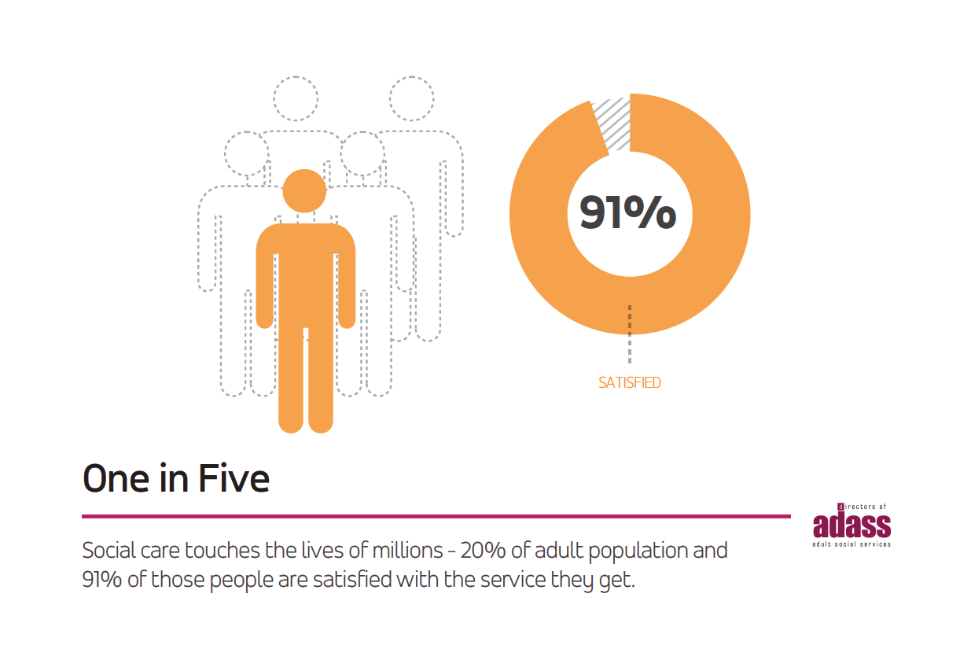

Slide 5
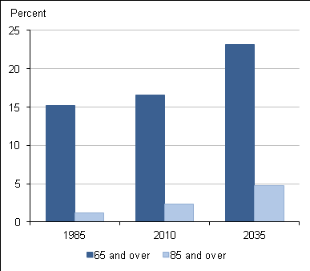
There is increasing need for care and support
We are all living longer
More older people are living with multiple long term health conditions
There are more adults living with a disability
This is cause for celebration, but also a challenge for services to focus on the whole person not a single disease.

Slide 6
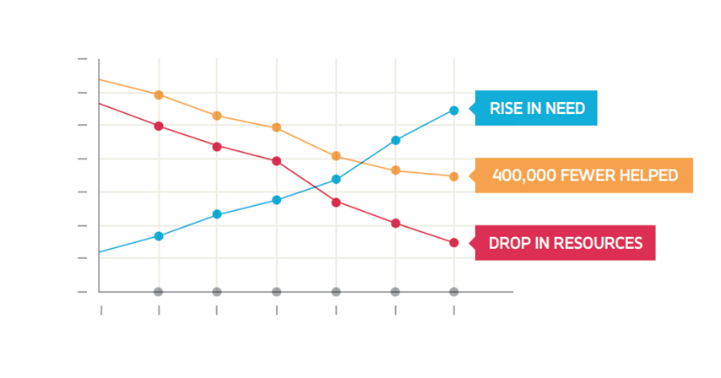

Presidential priority 1 - Resources
Resources have fallen with 5 years of funding reductions: £4.6b – 31% of real terms net budgets.
As a result social care helps 400,000 fewer people.

Slide 7
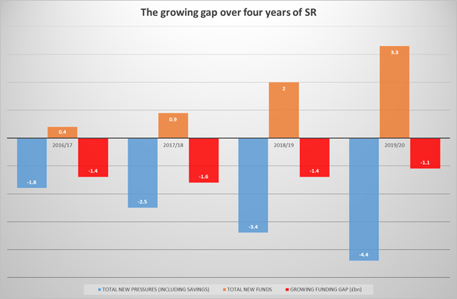
Presidential priority 1 - Resources
The trend is set to continue with a gap of at least £1-£2 billion throughout the next four years…
Need to prepare for 2020 now… Spending Reviews are not “won” in the months before but in the years before…

Slide 8
ADASS Priorities for 2016/17
Funding, the short term and kick start national campaign to raise the profile of social care for the next Comprehensive Spending Review
The sustainability of Care Markets, with particular emphasis on Care at Home
Integration with NHS, social care’s place in this
Social work- training and social work reform
Informal Carers

Slide 9
Presidential priority 2 – home care, markets and quality
The biggest reason for delays to people being discharged from hospital is ‘awaiting a care package at home’.
Carers should be recognised, valued and rewarded.
Quality is under pressure :CQC Board Paper Sept 2015: 41% of community-based adult social care services, hospice services and residential social care services inspected since last October were inadequate or required improvement.
People ho pay the full cost of their own care
  People who receive a direct payment (or who have a personal budget) from the council to pay for care

Slide 10
Presidential priority 3: social work reform
Developing the social work role to deliver the Care Act
Working with the PSWs and CSW
With ADCS, work with DfE and DH on the new regulatory body
Focus on safeguarding people’s rights in terms of compulsory admission or treatment, deprivation of liberty, abuse and neglect and community social work

Slide 11

Presidential priority 4 - integration and devolution
We want to see a system that is protected, aligned, and re-designed
DVP - ensure that new social and health care delivery models prioritise the need for:
  Personalised services which are more joined-up around the individual
  Good information and advice to enable us to look after ourselves
  Building supportive relationships
  Maintain independence
Money to ensure sustainability, capacity and quality - including living wage and workforce
Duty to integrate commissioning complimented by wider initiatives such as 5 Year Forward View, Better Care Fund and Devolution.

Slide 12



Presidential priority 5 - Carers Strategy
Recognise the vital role that carers play in our health and care economy
Looking to promote and support the essential role that local government can play in creating the right environment to support carers
Keen to engage with Government and the Department of Health on the development of the carers strategy
We need something more radical to support carers, as the proportion of those needing care, and those giving it, changes and as there is less state funded help available
We also need to be confident that this doesn’t exacerbate gender inequalities and that it has the capacity to address the issues of carers becoming poorer and less healthy in their own retirement

Slide 13


